Slide 1

Second-Generation Anti-Androgens: Managing Side Effects
Andrew J Armstrong MD ScM FACP NASPCC Webinar, August 2023 Professor of Medicine, Surgery, Pharmacology and Cancer Biology
Director of Research
Duke Cancer Institute’s Center for Prostate and Urologic Cancers

Slide 2
Outline
Changing landscape of advanced prostate cancer treatments
Earlier use of potent AR inhibitors in non-metastatic and hormone sensitive settings
New biomarkers emerging to guide need for and duration of hormonal therapy in localized prostate cancer
Higher cure rates when combined with radiation
Side effects of ADT and potent AR inhibitor use
Managing side effects: importance of survivorship
Balancing net risks and benefits to make personalized decisions

Slide 3
Some definitions
ADT=androgen deprivation therapy
Therapies that reduce testicular production of testosterone
Surgical: orchiectomy
GnRH agonists (Leuprolide, triptorelin, goserelin)
GnRH antagonists (degarelix, relugolix)
Androgen synthesis inhibitors
Therapies that reduce androgen production from all sources
Ketoconazole, abiraterone acetate formulations
Anti-androgens
Therapies that block the androgen receptor
First generation: flutamide, bicalutamide, nilutamide
Second generation: enzalutamide, apalutamide, darolutamide

Slide 4


“Traditional” PC Disease States – PCWG3 (Scher/Armstrong JCO 2017)
Clinical Metastases: Noncastrate
Castration- Resistant Metastatic (mCRPC):
1st Line
Clinically Localized Disease
Non- Castrate Rising PSA
mCRPC:
2nd Line
mCRPC:
3rd Line
mCRPC:
4th Line
Non- metastatic CRPC (nmCRPC)
Noncastrate
Castration-resistant
Death from Prostate Cancer
4

Slide 5

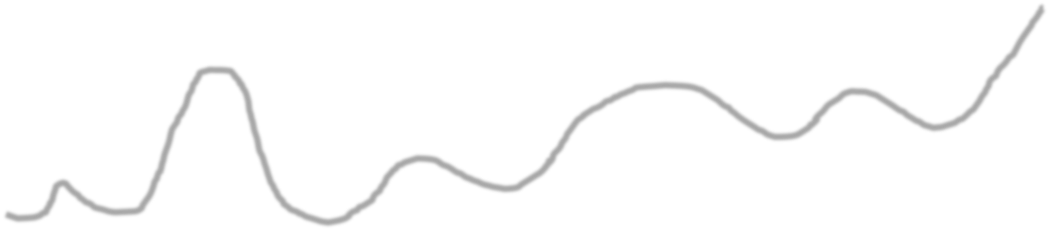

Natural History of Lethal Prostate Cancer and Treatment Options
Nonmetastatic
Metastatic
Tumor Volume and Activity
Castration Hormone Therapy
Cabazitaxel Enzalutamide Abiraterone Radium-223
Docetaxel
Local Therapy
Sipuleucel-T
Abiraterone or Enzalutamide Radium-223
MSI^{hi:} pembrolizumab HRD+: platinum or PARPi
PSMA PET+: Lu177-PSMA-617
M0: Apalutamide, Darolutamide or Enzalutamide
Asymptomatic
Symptomatic
Time

Slide 6

Men who Present with Metastatic Disease Unfortunately Face a Shorter Natural History
mHSPC at diagnosis comprises 5-10% of patients in the US, 30-70% of patients ex-US
Hormone-Sensitive Castrate-Resistant
Tumor Volume & Activity
Androgen Deprivation
+/- Docetaxel +/- Abi/Enza/Apa/Daro Radiation to primary (oligomets)
Death
Taxanes Radium-223
PSMA-PET+: PSMA-Lu177
MSI^{hi:} pembrolizumab HRD+: platinum or PARPi
Enzalutamide, Abiraterone
Time
Asymptomatic or Symptomatic
Symptomatic
Key Trials: STAMPEDE, LATTITUDE, CHAARTED, ARCHES, ENZAMET, TITAN, PEACE-1, ARASENS
Earlier use of potent AR therapy is changing our algorithm for subsequent therapy Integration of chemo-hormonal therapy with ADT OR novel AR therapies

Slide 7
mHSPC Therapies with Proven Survival Benefit
Therapy | Prior Docetaxel | Comparator | FFS/PFS benefit, HR, p-value | OS benefit, HR; p-value
Radiation to the Primary | No | No radiation, ADT alone +/- docetaxel | Yes: low volume HR 0.59 p<0.0001 | Yes: low volume HR 0.68 p=0.007
Enzalutamide ARCHES ENZAMET | 18% 44-45% | Placebo/ADT ADT/Bicalutamide | Yes HR 0.39 p<0.0001 Yes HR 0.39 p<0.0001 | Yes HR 0.66 p<0.0001 all volumes Yes HR 0.67 p=0.002 all volumes
Docetaxel/prednisone: STAMPEDE Docetaxel: CHAARTED Docetaxel/Abiraterone | No No Yes | ADT ADT Docetaxel/ADT | Yes HR 0.61 p<0.0001 Yes HR 0.61 p<0.0001 Yes HR 0.47-0.58 p=0.006, <0.0001 | Yes HR 0.76 p=0.005 all volumes Yes HR 0.63 p<0.001 high volume HR 1.04 low volume Yes HR 0.72 p=0.019 high volume de novo
Apalutamide | 11% | Placebo/ADT | Yes HR 0.48 p<0.001 | Yes HR 0.67 p=0.0053 all volumes
Abiraterone/Prednisone LATTITUDE Abiraterone/Prednisone STAMPEDE | No | Prednisone | Yes HR 0.47 p<0.0001 | Yes HR 0.66 p<0.001 high risk
 | No | Prednisone | Yes HR 0.31 p<0.0001 | Yes HR 0.61 p<0.001 all risk/volumes
Abiraterone/prednisone (PEACE-1) | 100% (concurrent) | ADT/Docetaxel | Yes HR 0.50 p<0.0001 | Yes HR 0.75 p=0.017; HV: HR 0.72 p=0.019
Darolutamide | 100% (concurrent) | Placebo/ADT/ Docetaxel | Yes CRPC HR 0.35 p<0.0001 | Yes HR 0.675 p<0.0001 de novo 86%
Parker et al Lancet 2018; Armstrong et al JCO 2019 and ESMO/JCO 2021; Davis et al NEJM 2019; James N et al Lancet 2015; Sweeney et al NEJM 2015; Chi KN et al NEJM 2019; Fizazi K et al NEJM 2017; James et al NEJM 2017; Smith MR et al NEJM 2022; Fizazi K et al Lancet 2022

Slide 8
mHSPC Algorithm 2023
Metastatic Hormone-Sensitive Prostate Cancer (mHSPC)
High-volume mHSPC (based on conventional imaging)
Low-volume mHSPC (based on conventional imaging)
Synchronous/de novo metastases
Metachronous/relapsed metastases
Synchronous/de novo metastases
Metachronous/relapsed metastases
Triplet therapy: Docetaxel + abiraterone + ADT Docetaxel + darolutamide + ADT
(preferred)
or
Docetaxel + ADT → ADT/enzalutamide Docetaxel + ADT → ADT/apalutamide
Triplet therapy: Docetaxel + ARSI + ADT vs.
Doublet therapy:
ADT + ARSI or docetaxel
Triplet therapy: Docetaxel + ARSI + ADT vs.
Doublet therapy:
ADT + ARSI or docetaxel
+
Radiation to the primary
(+/- pelvis)
Doublet therapy:
ARSI + ADT
McManus and Armstrong, JCO 2023

Slide 9
nmCRPC Therapies with Survival Benefit
Therapy | n | Eligibility | Comparat or | Indication | MFS HR; p | OS HR; p
Enzalutamide (PROSPER) | 933 | PSADT>10 mo, no N1 | Placebo/ADT | nmCRPC | 36.6 vs. 14.7 mo HR 0.29 p<0.001 | 67 vs 56.3 mo HR 0.73 p=0.001
Apalutamide (SPARTAN) | 1207 | PSADT>10 mo, N1 allowed <2 cm | Placebo/ADT | nmCRPC | 40.5 vs 16.2 mo HR 0.28 p<0.001 | 73.9 vs. 59.9 mo, HR 0.76; p=0.016
Darolutamide (ARAMIS) | 1509 | PSADT>10 mo, N1 <2 cm | Placebo/ADT | nmCRPC | 40.4 vs 18.4 mo HR 0.41 p<0.001 | NR vs NR HR 0.69 p=0.003
Hussain et al NEJM 2018 Sternberg CN et al NEJM 2020 Smith MR et al NEJM 2018 Smith MR Eur Urol 2021
Fizazi K et al NEJM 2019 Fizazi K et al NEJM 2020

Slide 10
ADVERSE EVENT CONSIDERATIONS
 | ARAMIS (Daro vs placebo) |  | SPARTAN (APA vs placebo) |  | PROSPER (ENZA vs placebo)
 | All Grades (%) |  | All Grades (%) |  | All Grades (%)
 | Daro | placebo | APA | placebo | ENZA | placebo
Hypertension | 7.3 | 6.0 | 25 | 20 | 12 | 5.2
Rash | 2.5 | 0.7 | 24 | 6 | NR | NR
Pruritus | NR | NR | 6.2 | 2 | NR | NR
Weight decreased | 3.6 | 2.2 | 16 | 6 | 5.9 | 1.5
Diarrhea | 6.9 | 5.6 | 20 | 15 | 10 | 10
Nausea | 5.0 | 5.8 | 18 | 16 | 11 | 8.6
Decreased appetite | 2.9 | 2.9 | 12 | 9 | 9.6 | 3.9
Hot flush | 5.2 | 4.6 | 14 | 9 | 13.0 | 7.7
Arthralgia | 8.1 | 9.2 | 16 | 8 | 8 | 7
Hypothyroidism | 0.2 | 0 | 8.1 | 2 | NR | NR
Cardiovascular events | Acute myocardial infarction |  | Ischemic heart disease |  | Major adverse cardiovascular event^{c}
 | 0.5 | 0.2 | 3.7 | 2
 | Cardiac failure |  | Heart failure |  | 5 | 3
 | 1.9 | 0.9 | 2.2 | 1

Slide 11
ADVERSE EVENT CONSIDERATIONS
 | ARAMIS (Daro vs placebo) |  | SPARTAN (APA vs placebo) |  | PROSPER (ENZA vs placebo)
 | All Grades (%) |  | All Grades (%) |  | All Grades (%)
 | Daro | placebo | APA | placebo | ENZA | placebo
Fatigue including Asthenia | 15.8 | 11.4 | 39 | 28 | 40 | 20
Fatigue (alone) | 12.1 | 8.7 | 30.4 | 21.1 | 33 | 14
Asthenia (alone) | NR | NR | NR | NR | 9 | 6
Headache | 3.9 | 2.5 | NR | NR | 9.1 | 4.5
Fracture | 4.2 | 3.8 | 12 | 7 | 9.8 | 4.9
Fall | 4.2 | 4.7 | 16 | 9 | 11 | 4.1
Seizure | 0.2 | 0.2 | 0.2 | 0 | 0.3 | 0
Dizziness | 3.7 | 2.5 | 9.3 | 6.3 | 12 | 5.2
Mental and cognitive changes
Cognitive disorder | 0.4 | 0.2 | NR | NR | NR | NR
Memory impairment | 0.5 | 1.3 | NR | NR | NR | NR
Mental impairment disorder^{e} | NR | NR | 5.1 | 3.0 | NR | NR
Cognitive and attention disorders^{f} | NR | NR | NR | NR | 4.6 | 1.5

Slide 12
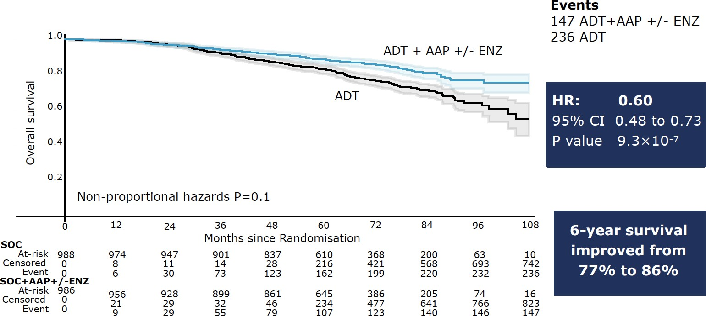

More Men will be Receiving Curative Intent ADT/Potent AR inhibition with RT in the High Risk/Very High Risk nmHSPC Setting: STAMPEDE
Kaplan-Meier estimates with 95% CI in lighter shade
Gerhardt Attard MD FRCP PhD
Content of this presentation is copyright and responsibility of the author. Permission is required for re-use.

Slide 13
Abiraterone vs. Enzalutamide vs. Apalutamide
Abiraterone acetate
Requires prednisone
Mineralocorticoid excess
Liver and electrolyte monitoring required
BP monitoring required
Some CV risk (afib, others)
Bone density monitoring recommended (fracture risk)
Exercise recommended (fatigue, muscle loss)
Beneficial in high and low volume/risk patients
Can be safely given with RT
Enzalutamide or Apalutamide
No prednisone requirement
No mineralocorticoid excess
No liver/electrolyte monitoring required
BP monitoring required
Fatigue, fracture risk
Bone density monitoring recommended (fracture risk)
Exercise recommended (fatigue, muscle loss)
Minimal seizure risk <1%, but careful in patients with h/o seizures, strokes
Apalutamide rash in ~30% can be significant (not enzalutamide)
Beneficial in high and low volume/risk patients
Can be safely given with RT

Slide 14
Advantages of darolutamide
No CNS penetration, thus reduced impact on cognition, falls
No major increased risks of falls or fracture
Minimal CV risks
No need for steroids
Proven survival benefit with docetaxel in mHSPC and as monotherapy with ADT in nmCRPC

Slide 15
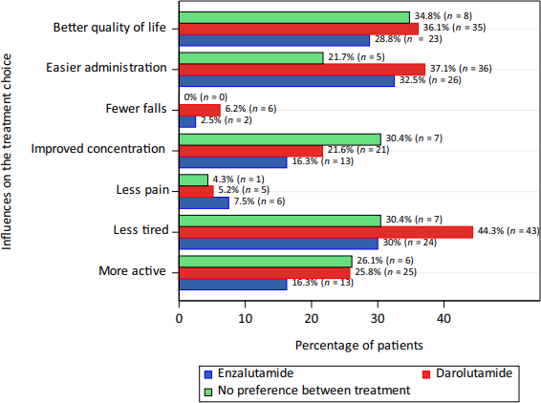
Darolutamide
Randomized patient preference trial of enzalutamide vs darolutamide (ODENZA), n=200, all mCRPC
49% of patients chose darolutamide vs 40% who preferred enzalutamide (non-significant difference) while 12% had no preference
Main reasons to prefer darolutamide or enzalutamide were reduced fatigue, ease of administration, QOL
PSA decline of >=50% was seen in 76% vs 84% in the first period and 29% vs 55% during the cross over period, favoring enza
Fewer issues with impaired verbal learning/memory with darolutamide (small differences)
More fatigue reported with enza, similar hot flashes and joint pains
Colomba E et al Eur Urol 2023

Slide 16
Suggested treatment algorithm for men with HSPC
nmHSPC M0 N0
(localized high/very high NCCN risk)
ADT plus radiotherapy to prostate +/- pelvis
(+/- brachytherapy) plus consideration of
abiraterone acetate/prednisone x 24-36 months (STAMPEDE) or
RP/ELND and likely early salvage RT +/- ADT
ADT plus radiotherapy (primary +/- pelvis) unless prior local therapy
Plus either:
Abiraterone acetate with prednisone Enzalutamide or Apalutamide
Treat until progression
Consider metastasis directed therapy (not level 1)
Docetaxel an option in de novo M1
Ongoing trials: ENZARAD, ATLAS
mHSPC low volume/risk or N1 M0
ADT plus either:
Docetaxel without prednisone x 6
Abiraterone acetate with prednisone Enzalutamide or Apalutamide
Consider ADT/docetaxel→ADT/enza or apa OR ADT/docetaxel concurrently with abi or daro for high volume disease or inadequate response to initial ADT/docetaxel
Treat until progression
Treat primary only if symptomatic
mHSPC high volume/risk
High volume = presence of
visceral (i.e. liver, lung, adrenal) metastases or
≥4 bone lesions with ≥1 beyond the vertebral bodies and pelvis (CHAARTED, NEJM 2015)
Genetic testing recommended for all of these men!
16

Slide 17
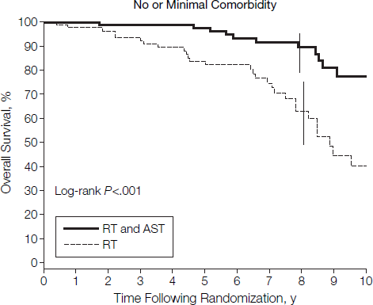
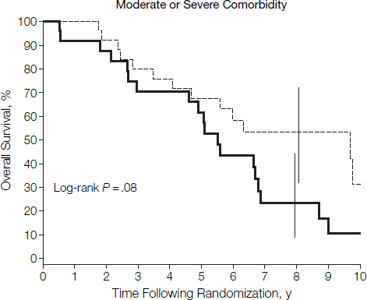
Principles of Hormonal Therapy For Localized PC
4-6 months of ADT preferred for intermediate risk PC with radiation (prior to, during, post IMRT), especially men with few to no CV comorbidities
2-3 years of ADT preferred for high risk men treated with IMRT, especially in men with few to no CV comorbidities (RTOG 9202)
No ADT is indicated prior to surgery or adjuvant to surgery except in men with node positive disease (Messing trial) but controversial
No data with ADT and brachytherapy or in salvage XRT setting (ongoing studies)
Discussion of risks and benefits is essential!
Pelvic radiation benefits are uncertain (ongoing phase 3)
D’Amico JAMA 2008

Slide 18
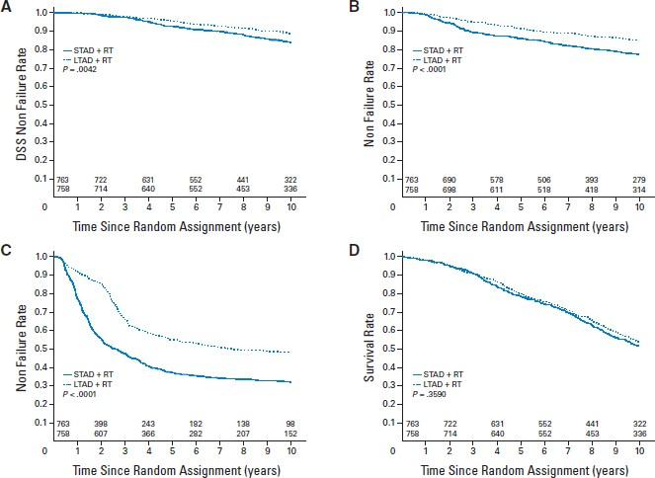
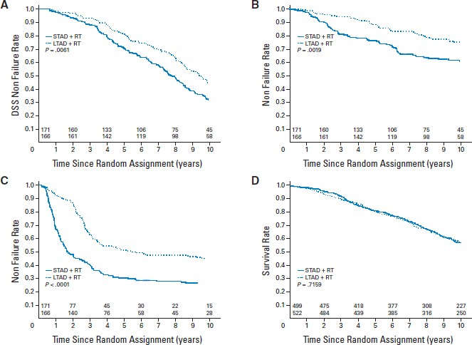
Long term ADT for High risk Localized PC
All patients in RTOG 9202:
10 yrs f/u, n=1554, included pelvic RT
Gleason 8-10 n=361
Improved OS, MFS, PSA PFS, and DSS
STADT (4 mo) vs LTADT (28 mo)
Improved DSS, PSA relapse, MFS, no OS benefit
Eligibility: T2c-T4, N0, PSA<150
Horwitz E et al JCO 2008

Slide 19
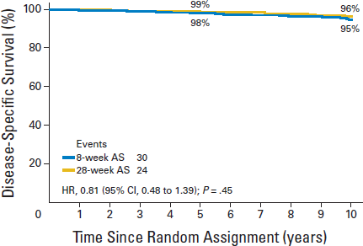
4 months of ADT with IMRT may be Sufficient for Intermediate Risk PC
RTOG 9910 randomized 1579 men with int. risk PC to 8 vs 28 weeks of ADT with IMRT (given pre-XRT with 8 more weeks concurrent to radiation)
No differences seen with longer duration of ADT in overall survival, PC specific survival, metastasis or PSA recurrence rates
Suggests 16 weeks of ADT is sufficient for these patients
Pisansky TM et al, JCO 2014

Slide 20
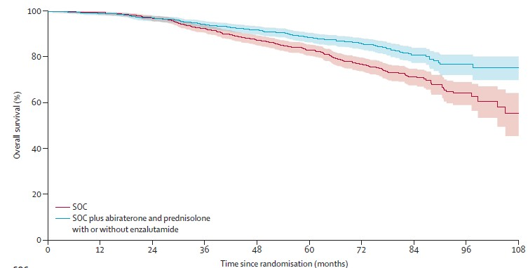
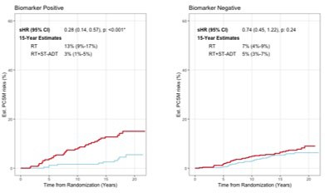
Emerging areas in localized PC
1. Improved survival in high/very high risk men with IMRT and potent AR inhibition (abiraterone) and
evaluating potent shorter courses of hormonal therapy
Use of AI biomarkers to identify men with intermediate/high risk PC who benefit from ADT and thus who can also avoid ADT
Comparative studies of surveillance vs surgery vs RT and different forms of RT (photons, protons, seeds) or surgery (robotic vs open)
Attard et al Lancet 2021
Spratt et al NEJM Evidence 2023

Slide 21

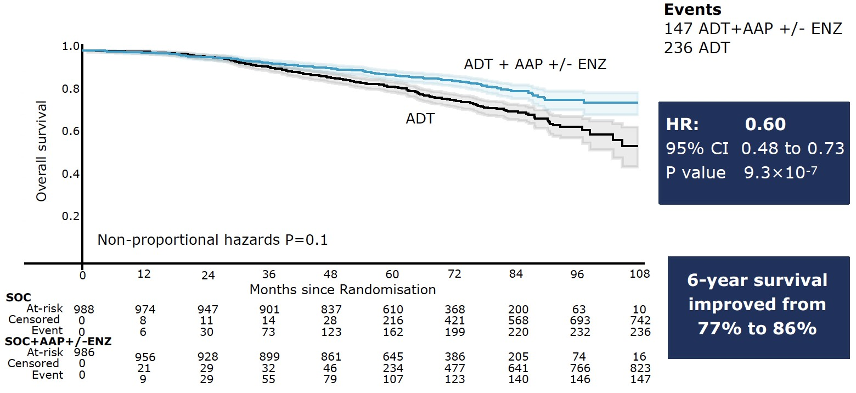
STAMPEDE Update
M0 very high risk patients. Both MFS and OS significantly improved with 2 years of abiraterone with IMRT +/- pelvic RT
N=1974
2011 2012 2013 2014 2015 2016
SOC: ADT x 3 years + RT^
1:1 randomization
SOC + AAP (2y)
SOC + AAP+ENZ (2y)
Solid bars: period of accrual
^ When indicated
ESMO = European Society for Medical Oncology; FU = fluorouracil.
Attard G, et al. Eur Urol. 2021;80(4):522-523. Jayaram AK, et al. Ann Oncol. 2019;30(7 Suppl):vii3-vii4. Morris MJ, et al. J Clin Oncol. 2019;37(15 Suppl):5008. Attard et al Lancet 2021

Slide 22
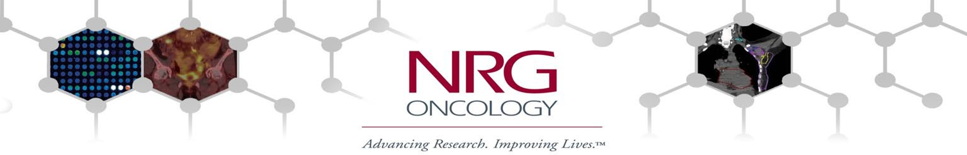





Development and validation of an AI-derived digital pathology-based biomarker to predict benefit of long-term androgen deprivation therapy with radiotherapy in men with localized high-risk prostate cancer across multiple phase III NRG/RTOG trials
Andrew J. Armstrong, Vinnie Y.T. Liu, Ramprasaath R. Selvaraju, Emmalyn Chen, Jeffry P. Simko, Sandy Devries, A. Oliver Sartor, Howard M. Sandler, Osama Mohamad, Andre Esteva, Phuoc T. Tran, Daniel E. Spratt, John H. Carson, Christopher Peters, Elizabeth Gore, Steve P. Lee, Jedidiah M. Monsoon, Joseph P. Rodgers, Felix Y. Feng, Paul L. Nguyen
2023 ASCO – June 4th, 2023
@AarmstrongDuke @DukeCancer
ArteraAI
@DrPaulNguyen @NRGOnc

Slide 23















Development of Predictive Biomarker for the Benefits of Long-Term ADT in High-Risk Prostate Cancer
NRG/ RTOG 9413
NRG/ RTOG 9910
NRG/ RTOG 0126
NRG/ RTOG 0521
NRG/
RTOG
9408
Image Feature Extraction Model Training in
6 NRG Phase 3 Trials
NRG/ RTOG 9902
Predictive Model Training
(n = 2,641)
Intermediate & High-Risk Patients Only
Patients Treated with RT + ADT
Only
External Validation in NRG/RTOG 9202
(n = 1,192)
ArteraAI LT-ADT Predictive Biomarker

Slide 24
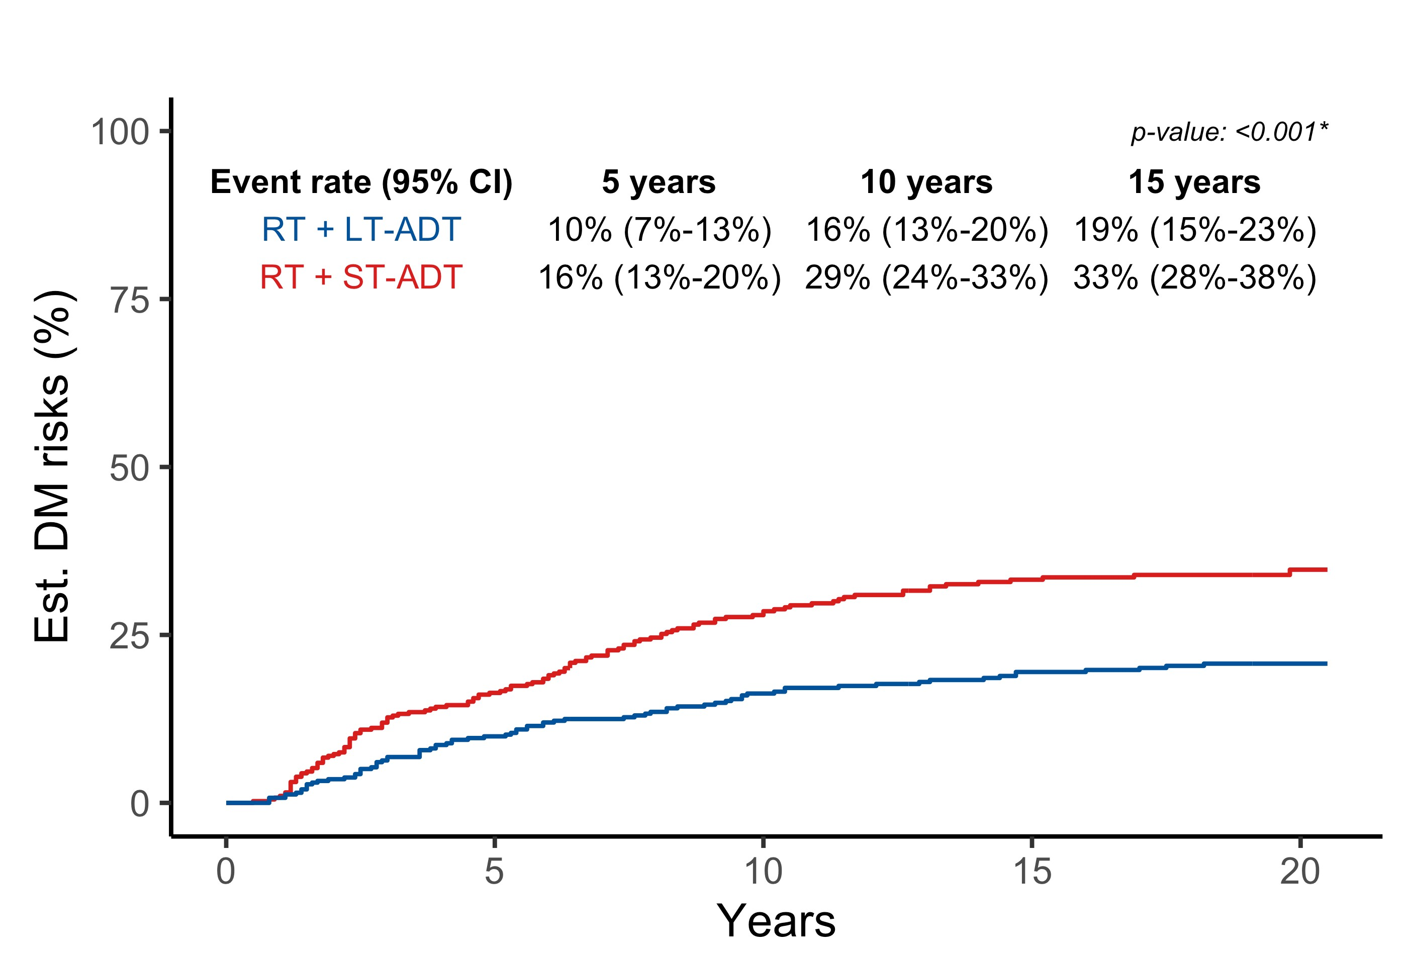
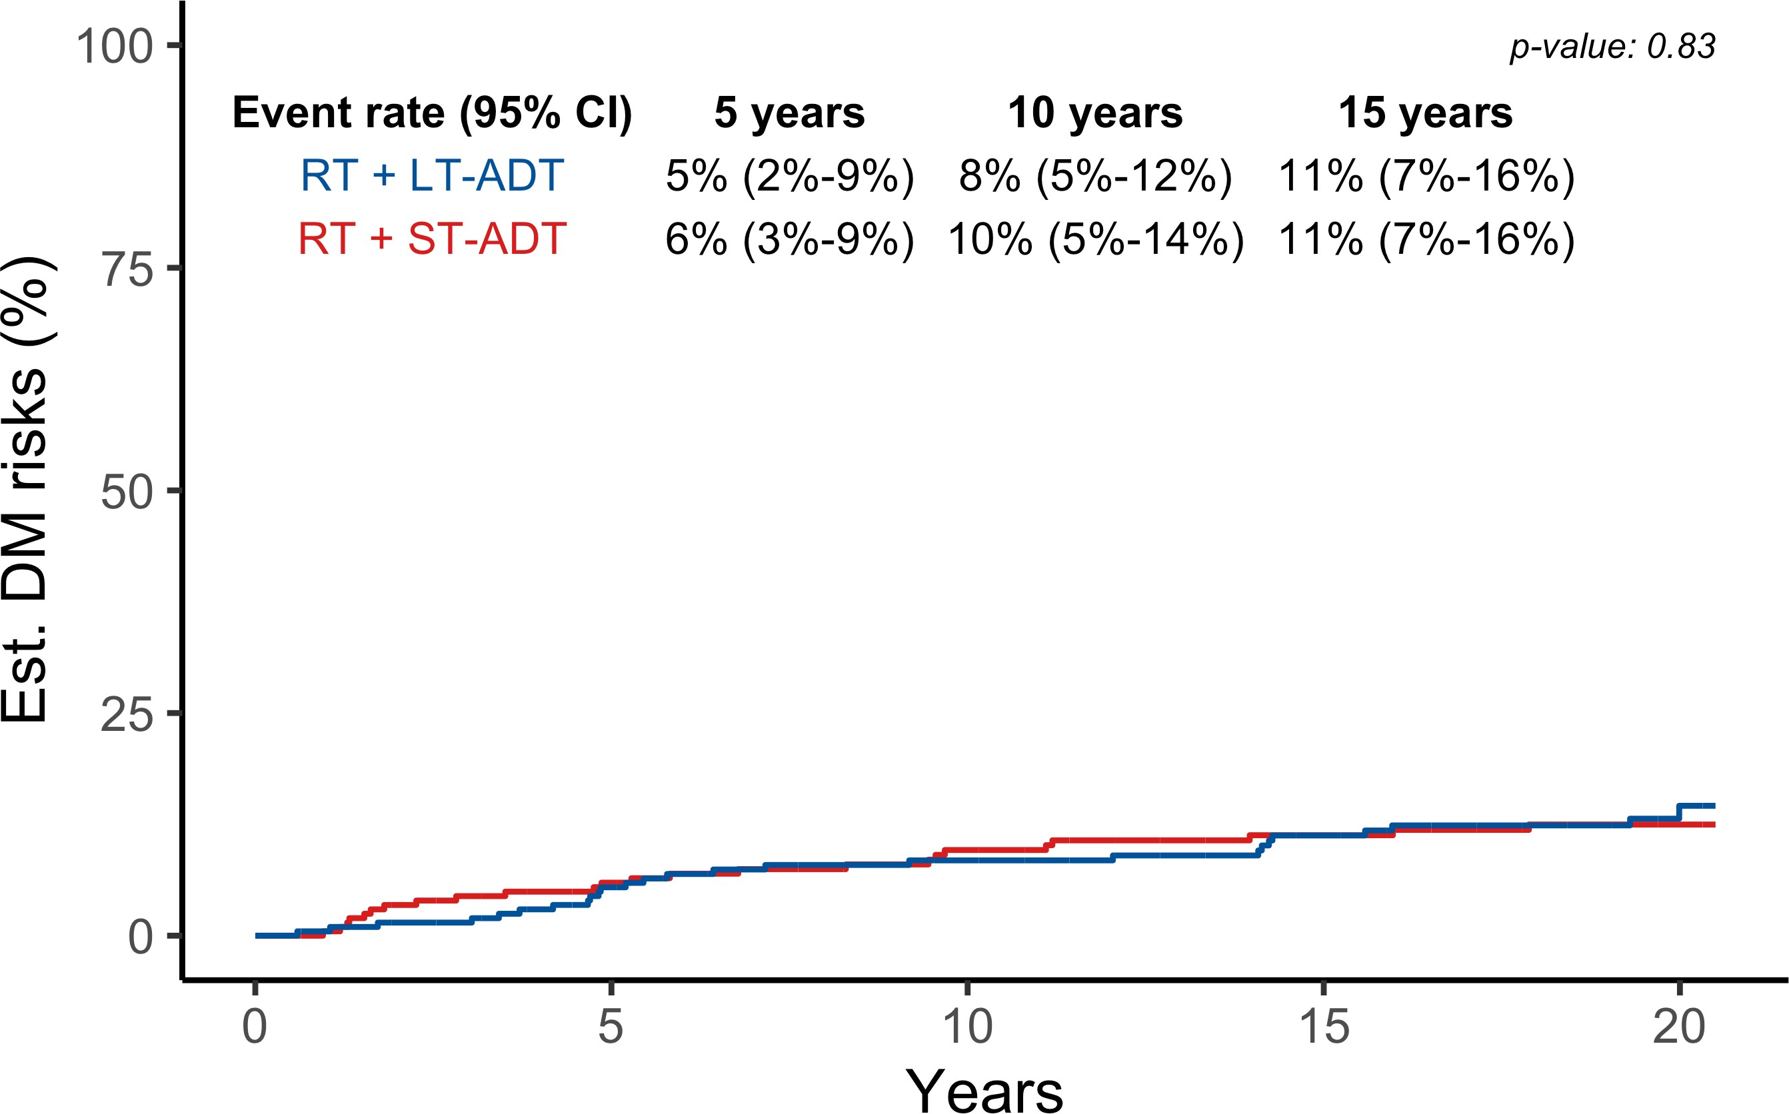
Primary Endpoint Results (DM)
~⅓ of men with high-risk prostate cancer could safely avoid LT-ADT
254 men (21%) developed DM, and risk differed by AI Biomarker groups AND treatment
Biomarker Negative Group (n = 407)
Biomarker Positive Group (n = 785)
Interaction p = 0.04
ST-ADT + RT
LT-ADT + RT
HR 1.06 (0.61 - 1.84), p = 0.84
HR 0.55 (0.41 - 0.73), p < 0.001

Slide 25
Importance of Survivorship
Prostate cancer remains the #1 survived cancer in the US
Men are living longer with prostate cancer even if cure is not possible
Lifestyle factors contribute to aggressive disease, survival, cardiovascular risk and are reversible
Obesity, fitness, plant-enriched diet, cruciferous vegetables, reduced processed foods, sugar-sweetened foods, avoidance of tobacco
Mental health
COVID-19 vaccination
Long term attention to and monitoring of bone, muscle, heart health is critical!

Slide 26
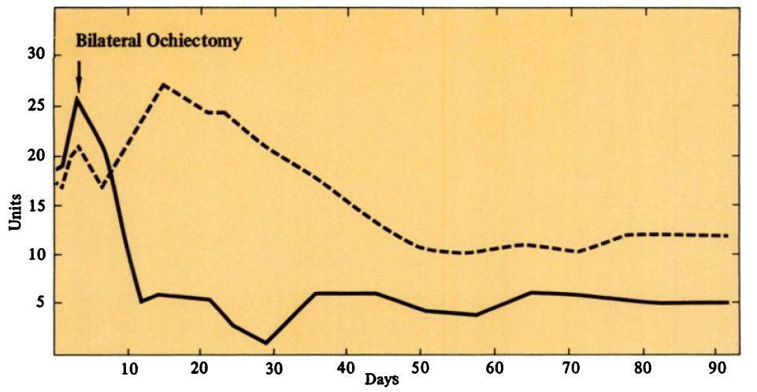
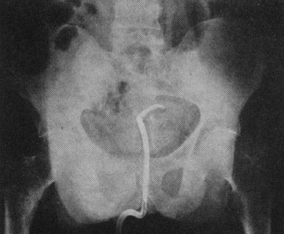
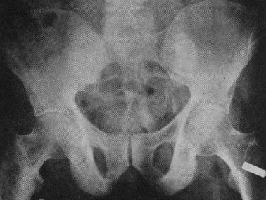
Androgen Deprivation Therapy
Evolved over time after initial nobel-prize winning observations by Huggins and Hodges (1941)
Orchiectomy still cost effective!
LHRH agonists, antagonists used today with various formulations (depot injections)
Adrenalectomies have changed into ketoconazole or abiraterone for secondary hormonal therapy to lower androgen levels
Anti-androgen therapy may add to this benefit but with some risk/cost, used initially to prevent “flare”
Alk phos
PAP
Huggins and Hodges, Cancer Res 1941,
Arch Surg 1941

Slide 27
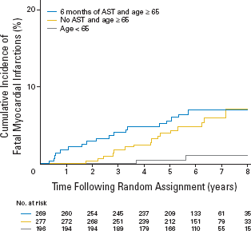
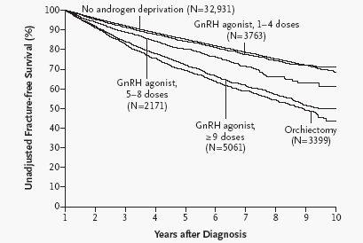
Complications of Androgen Ablation
Diabetes (1.44x increased risk)
MI and sudden cardiac death (1.11 to 1.16x increased risk), stroke, DVT
Fracture of any bone (1.21x), hip (1.76x), and lower spine (1.18x)
Erectile dysfunction, loss of libido
Metabolic syndrome and weight gain (55% vs 25%)
Hot flashes, mood lability
Gynecomastia (especially MAB)
Fatigue, memory impairment, fall risk
Alopecia (5%)
Normocytic anemia (15%)
Liver toxicity (2-7%) with anti-androgens
Basaria M, et al. J Clin Oncol. 2006;24:3379-3983. D’Amico A, e tal. J Clin Oncol. 2007;25:2420-2425. Shahinian V, et al. NEJM. 2005; 352:154-164

Slide 28
Mitigating ADT Adverse Events
Exercise: aerobic and weight bearing
Reduces fatigue and hot flashes, improves fall risk, energy, strength
30-45” of individualized exercise plan (aerobic, light weights but can be more) 4-5x/week
Reduces sarcopenia, fat redistribution
Improved lipid profiles, metabolic syndrome, CV risk, bone health
Survivorship clinic, integration with primary care
Addressing CV risk factors
Diet, HTN, smoking, lipids, diabetes, weight loss
Cardiology evaluation for high risk men
Hot flush management
Megace, SSRIs, gabapentin, exercise, estrogen patches, oxybutynin, cooling wrist bands
Calcium and vitamin D, bone anti-resportive therapies
– 1200 mg/d, at least 800 IU/day, periodic bone density checks
Galvao D, JCO 2010

Slide 29
Why Intermittent Androgen Deprivation?
Based on the premise that removing the selection pressure of castrate levels of testosterone may delay emergence of CRPC and death; some preclinical data but largely disproven clinically
Certainly more cost effective (less drug used)
Planned holidays off ADT may promote greater quality of life, well-being
Hot flashes, ED, fatigue, bone loss improve
Cardiovascular/metabolic risks?
Problem is that it takes a long time to recover T
Trials in non-metastatic prostate cancer have shown comparable efficacy and reduced toxicity (23 phase 2 trials, 6 phase 3 trials, thousands of men enrolled)
Perhaps lower non-PC mortality tradeoff vs. higher PC specific mortality (1)
1) NCIC Pr7 Trial, Crook, Proc ASCO 2011

Slide 30


Intermittent ADT Approach
On Treatment
Off Treatment
Variable period
Depending on degree of PSA rise (10-20 or individualized)
Fixed period
6-12 months or until PSA nadir (0-4) reached
Considerations: PSADT, testosterone recovery time, comorbidities, side effects, PSA production by tumor, M0 vs. M1 disease
Boccon-Gibod BJU Int 2007

Slide 31
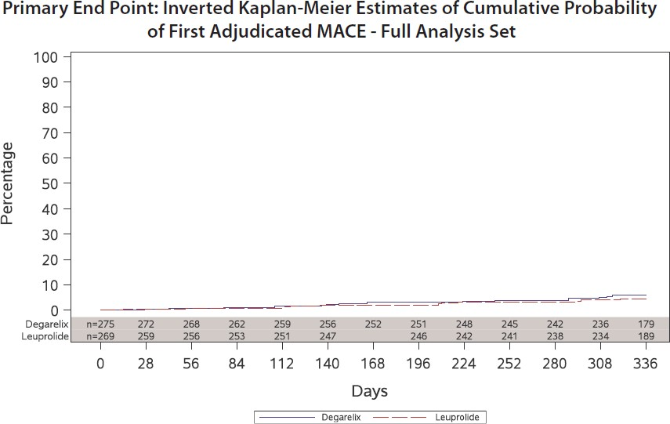
Are GnRH agonists or antagonists preferred?
Some retrospective studies suggested that degarelix may have reduced CV risks to GnRH agonists, but these all had issues with potential design flaws and bias
Only randomized trial (PRONOUNCE) failed to show any differences in CV outcomes as long as CV risks were managed
MACE occurred in 15 (5.5%) patients
assigned to degarelix and 11 (4.1%)
patients assigned to leuprolide
(HR 1.28 [95% CI, 0.59–2.79]; P=0.53)
Lopes, RD et al Circulation 2022

Slide 32
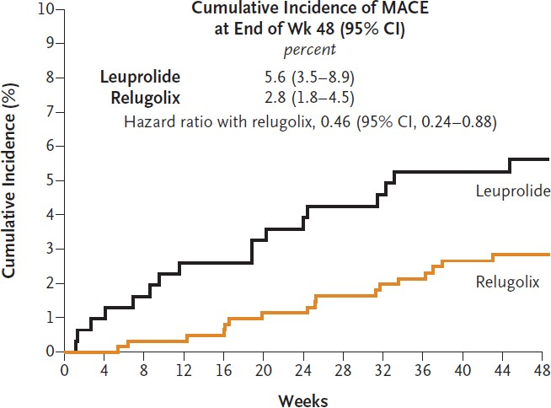
Relugolix
Oral GnRH antagonist
More rapid onset of castration and more rapid recovery
Some suggestion of reduced CV risks vs Leuprolide but this was not a centrally adjudicated endpoint and could be biased
The REPLACE-CV phase 3 study is now ongoing and examining CV risks of degarelix vs leuprolide in advanced
prostate cancer: NCT05605964 (n=2250)
Shore ND et al NEJM 2020

Slide 33











Enzalutamide: Second Generation Androgen Receptor Inhibitor
T
T
Enzalutamide:
1 Inhibits
binding of androgens to AR
AR
Cell cytoplasm
2
Inhibits
AR nuclear translocation
AR
Cell nucleus
3
Inhibits
AR-mediated DNA binding
AR = androgen receptor T = testosterone.
Tran C, et al. Science. 2009;324:787-790. Scher HI, et al. N Engl J Med. 2012;367:1187-1197.
All Rights Reserved, Duke Medicine 2007

Slide 34
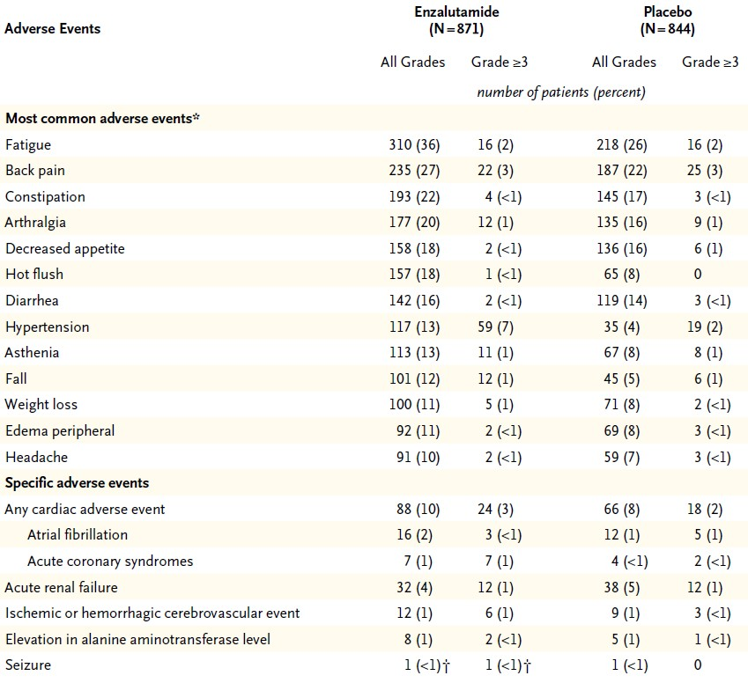
Chemo-Naive Enzalutamide AEs
Beer TM, Armstrong AJ, et al. NEJM. 2014;371:424-433.
All Rights Reserved, Duke Medicine 2007

Slide 35
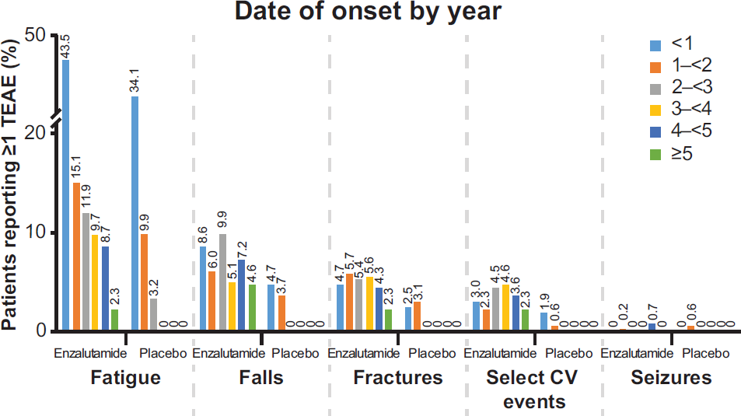
Enzalutamide Side Effects Over Time: Long Term Data
Armstrong AJ et al European Urology 2020

Slide 36
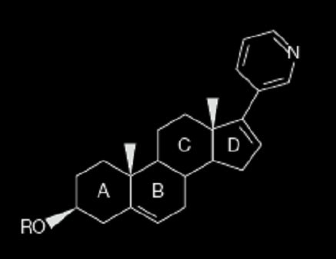
Abieraterone Acetate
+ Prednisone
Cholesterol
Desmolase
Renin
Pregnenolone
Progesterone
Deoxy-
Corticosterone
Aldosterone
corticosterone
X
CYP17
11β-
17α-hydroxylase
Hydroxylase
17α-OH-
17α –OH-
11-Deoxy- cortisol
Cortisol
ACTH
pregnenolone
progesterone
CYP_{X}17
Autocrine and paracrine (adrenal) pathways
C17,20-lyase
5α-reductase
DHEA
Androstenedione
Testosterone
DHT
CYP19: aromatase
Estradiol
Attard G, et al. J Clin Onc. 2008;26:4563-4571.
All Rights Reserved, Duke Medicine 2007

Slide 37
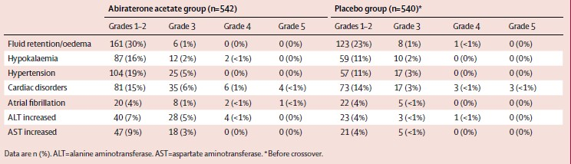
Abiraterone acetate AEs
Ryan CJ, et al. Lancet Oncol. 2015;16:152-160.
All Rights Reserved, Duke Medicine 2007

Slide 38








Multidisciplinary Care
Medical Oncology
Genetic counselors
Rad Onc & Radiology
The patient and their family/ caregivers
Palliative care, nursing
Urologic Oncology
Community Support
Primary Care

Slide 39










Monitoring and Management of Major AR Therapy Side Effects
Risk
CV
Fracture
Fall
SSE
Fatigue
Management/monitoring
Monitor
Calcium, vitamin D, exercise
Exercise
Reduce bone turnover with e.g. denosumab
Exercise
39
AE, adverse event; CV, cardiovascular; SSE, symptomatic skeletal event.

Slide 40
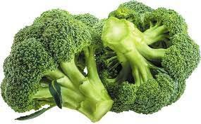
Key Survivorship Tips
Achieve and Maintain a Healthy Body Weight (BMI<25, waist circumference<40”)
Engage in Regular Physical Activity: avoid inactivity, 150”/week moderate intensity exercise or 75”/week vigorous activity at minimum, mixture of strength and conditioning aerobic activity
Eat a healthy diet. Limit processed foods and red meat, trans fats, eat 2.5 cups or more of vegetables>fruits daily, whole grains, avoid added sugar. Many healthy diets (Mediterranean, low carb), moderate fish/nut intake, cruciferous veggies (broccoli, cauliflower, bok choy, brussel sprouts, broccolini, etc)
Limit alcohol, avoid tobacco
Bone health. Regular exercise, Ca 1200 mg/d plus D3 800 IU/d
Avoid mega vitamins (just eat real food)
Manage stress, depression, anxiety: support groups, churches, social groups, professional support, spouses
Take care of the rest of you. Cardiovascular disease remains the #1 killer among men with prostate cancer. Blood pressure & lipid monitoring, cancer screening for example.

Slide 41
Questions?
Thank you!
Some resources:
Prostate Cancer Foundation: https://www.pcf.org/patient-resources/
American Cancer Society: https://www.cancer.org/content/dam/CRC/PDF/Public/8796.00.pdf NCCN: https://www.nccn.org/patients/guidelines/content/PDF/prostate-advanced-patient.pdf

