Slide 1
The Evolving Treatment Landscape in Prostate Cancer:
Dan George, MD
Eleanor Easley Distinguished Professor of Medicine and Surgery
Leader, DCI Center for Prostate and Urologic Cancers
Duke Cancer Institute

Slide 2
Disclosures
Advanced Accelerator Applications – Consulting
Ambrx - Consultant
American Association for Cancer Research – Sr Editor
Astellas – Consultant, Research, Advisory Board
Astrazeneca – Research, Consultant, Advisory Board, CAPI-281 Steering Committee member, IDMC
Axess Oncology – Independent Contractor
Bayer H/C Pharmaceuticals – Consultant, Honorarium, Travel accommodations, SC
BMS – Consultant, Research, Steering Committee
Calithera – Research
Capio Biosciences – Scientific Advisory Board
Constellation Pharmaceuticals - Consultant (09/2020)
EMD Serono - Honorarium
Exelixis, Inc – Research, Consultant, Honorarium, Expert witness, Travel accommodations
Flatiron – Consultant
Ipsen - Honorarium
Janssen Pharmaceuticals – Research, Consultant, Independent Data Monitoring Committee (IDMC)
Merck Sharp & Dohme – Consultant, Research
Michael J Hennessey Associates – Honorarium, Consultant
Millennium Medical Publishing, Clinical Advances in Hematology & Oncology – Co-Editor-in-Chief
Modra Pharmaceuticals B.V. – Advisory Board
Myovant Sciences, Inc – Consultant
Nektar Therapeutics – Steering Committee
Novartis – Research, Consulting
Physician Education Resource LLC - Consultant
Pfizer – Research, Consultant, Steering Committee, Honorarium
Propella TX – Consultant
Sanofi – Research, Consultant
UroGPO - Honorarium
UroToday – Honorarium, Travel accommodations

Slide 3
Multiple pathways to advanced mCRPC disease state
mCSPC
Metastatic, castrate-sensitive prostate cancer
Advanced Disease: mCRPC
Metastatic, castration-resistant prostate cancer
May require multiple lines
of therapy
Localized Disease
Biochemical Recurrence
Transitional Disease: nmCRPC
Predominantly adenocarcinomas
Treatment is based on risk stratification (very low to very high)
Cancer has spread to local lymph nodes or other nearby tissue
Also known as rising PSA non-castrate
non-metastatic, castration-resistant prostate cancer
Scher HI et al. J Clin Oncol. 2016;34(12):1402-1418.

Slide 4
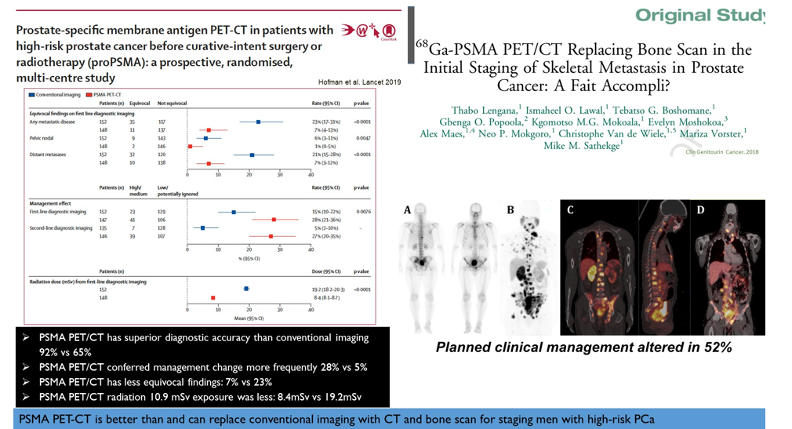
PSMA PET is changing our understanding of disease targeting and tumor burden in advanced prostate cancer

Slide 5
Three Important Events in Prostate Cancer Progression Include Biochemical Recurrence, Castration resistance, and Detection of Metastases
Biochemical
Recurrence
Castration
Resistance
Metastases
Rising PSA levels after local treatment indicates recurrent disease
Rising PSA levels on ADT indicates a change in disease state
PSA Progression
Failure of ADT
Initiation of ADT
Rising PSA, cancer may have spread to local lymph nodes (transitional)
Development of metastases represents change in disease stage and prognosis
Disease Burden
Localized Disease
Biochemical Recurrence
Transitional Disease
(Non-metastatic)
Advanced (Metastatic) Disease
Asymptomatic
Symptomatic
Higano CS et al. In: Figg W, et al. (eds.) Drug Management of Prostate Cancer. New York, NY: Springer; 2010;321-327.

Slide 6
Phase 3 clinical trials in mHSPC have explored a number of systemic therapies (1/2)
Docetaxel
Abiraterone
Darolutamide
 | CHAARTED NCT00309985¹ | STAMPEDE ARM C NCT00268476³ | STAMPEDE ARM G NCT00268476⁵ | LATITUDE NCT01715285⁷ | ARASENS NCT02799602⁹
N | 790 | 1086⁴ | 1917⁶ | 1209 | ~1300
Investigational treatment arm(s) | Docetaxel + ADT | Docetaxel + prednisone + ADT | Abiraterone + prednisone + ADT | Abiraterone + prednisone + ADT | ADT + darolutamide + docetaxel
Comparator arm | ADT | ADT* | ADT* | Placebo + ADT | ADT + docetaxel
Objective | To see how well ADT and chemotherapy work compared with ADT alone in treating patients with mPC | To assess novel approaches for the treatment of men with prostate cancer who are starting long-term ADT for the first time (high-risk nmPC or newly diagnosed mPC) |  | To determine if men with newly diagnosed (≤3 months) mHSPC with high-risk prognostic factors will benefit from addition of abiraterone and low-dose prednisone to ADT | To evaluate the addition of the AR inhibitor darolutamide to standard ADT and docetaxel in men with mHSPC
OS (HR for death) | 0.72 (0.59–0.89); p=0.0018² | 0.81 (0.69–0.95); p=0.009⁴ | 0.63 (0.52–0.76); p <0.001⁶ | 0.66 (0.56–0.78); p <0.0001⁸ | 0.68 (0.57-0.80) P < 0.0001⁹

Slide 7
Phase 3 clinical trials in mHSPC have explored a number of systemic therapies (2/2)
Enzalutamide
Apalutamide
TAK-700
 | ARCHES NCT02677896¹ | ENZAMET NCT02446405² | PEACE-1 NCT01957436³ | TITAN NCT02489318⁵ | SWOG S1216 NCT01809691⁷
N | 1150 | 1125 | ~1173 | 1052 | 1313
Investigational treatment arm(s) | Enzalutamide + ADT | Enzalutamide + ADT | ADT + docetaxel + abiraterone (+ prednisone) ADT + docetaxel + RT ADT + docetaxel + abiraterone (+ prednisone) + RT | Apalutamide + ADT | ADT + TAK-700 (nonsteroidal CYP17A1 inhibitor)
Comparator arm | ADT + placebo | ADT + conventional NSAA | ADT + docetaxel | ADT + placebo | ADT + bicalutamide
Objective | To evaluate the efficacy of enzalutamide plus ADT as measured by rPFS based on central review and safety of this regimen | To determine the effects of adding enzalutamide to first-line treatment that included testosterone suppression with or without early docetaxel | To compare the clinical benefit of ADT (+ docetaxel) ± local RT, with or without abiraterone and prednisone, in mHSPC | To determine if the addition of apalutamide to ADT provides superior efficacy in improving rPFS or OS for men with mHSPC | To evaluate whether ADT plus TAK-700 or bicalutamide prolongs survival in men with newly diagnosed mHSPC
OS (HR for death) | 0.66 (0.53 - 0.81) p <0.001¹ | 0.67 (0.52–0.86); p=0.002² | 0·82 (0·69-0·98) p=0·030 | 0.67 (0.51–0.89); p=0.005⁶ | NR

Slide 8
Second-generation ARPIs in mCSPC Extend Survival, but New Approaches With Novel MoAs Are Needed
 | TITAN¹ |  |  | ARCHES² |  |  | ENZAMET³
 | Apalutamide (n = 525) | Placebo (n = 527) | Placebo (n = 527) | Enzalutamide (n = 574) | Placebo (n = 576) | Placebo (n = 576) | Enzalutamide + LHRH or surgical castration ± docetaxel (n = 563) | NSAA + LHRH or surgical castration ± docetaxel (n = 558)
Median OS, months | NR | NR | NR | NR | NR | NR
HR (95% CI) | 0.67 (0.51-0.89)† |  |  | 0.81 (0.53-1.25) - interim |  |  | 0.66 (0.53-0.81)‡
Median PFS, months | NR |  | 22.2 | NR |  | 19.5
HR (95% CI) | 0.48 (0.39-0.60)**^{,a} |  |  | 0.39 (0.30-0.50)** |  |  | 0.39 (0.33-0.47)*^{,b}
Median TTC, months | NR |  | NE | 30.2 |  | NR
HR (95% CI) | 0.39 (0.27-0.56)** |  |  | 0.28 (0.20-0.40)**
*P <.001; **P <.0001; ‡ P =.002
MOA, mechanism of action; NE, not evaluable; NR, not reached; NSAA, nonsteroidal antiandrogen therapy.
ªDefined as time to radiographic progression or death, whichever occurs first.
^{b}Defined as time to PSA rise, clinical progression, or death
1. Chi KN et al. N Engl J Med. 2019;381(1):13-24. 2. Armstrong AJ et al. J Clin Oncol. 2019:JCO1900799. 3. Davis ID et al. N Engl J Med. 2019;381:121-131

Slide 9
Docetaxel Chemotherapy is an Alternative Treatment Option for mCSPC in Patients
 | CHAARTED¹ |  | LATITUDE^{2,3}
 | Docetaxel (n = 397) | Placebo (n = 393) | Abiraterone (n = 597) | Placebo (n = 602)
Median OS, months | 57.6 | 44.0 | 53.3 | 36.5
HR (95% CI) | 0.61 (0.47-0.80)* |  | 0.66 (0.56-0.78)**
Median PFS, months | 33.0 | 19.8 | 33.0 | 14.8
HR (95% CI) | 0.61 (0.50-0.75)*^{,a} |  | 0.47 (0.39-0.55)*^{,b}
Median TTC, months |  |  | NR | 38.9
HR (95% CI) |  |  | 0.44 (0.35-0.56)*
*P <.001; **P <.0001; NR, not reached.
ªDefined as increasing symptoms of bone metastases; progression according to the Response Evaluation Criteria in Solid Tumors, version 1.0; or clinical deterioration due to cancer according to the investigator’s opinion.
^{b}Defined as radiographic progression of soft-tissue lesions evaluated by either CT or MRI on the basis of RECIST, version 1.1, or progression on bone scanning by adaptation of Prostate Cancer Working Group 2 criteria.
1. Sweeney CJ, et al. N Engl J Med. 2015;373(8):737–746. 2. Fizazi K, et al. N Engl J Med. 2017;377:352-360. 3. Fizazi K, et al Lancet. 2019;20(5):686-700.

Slide 10
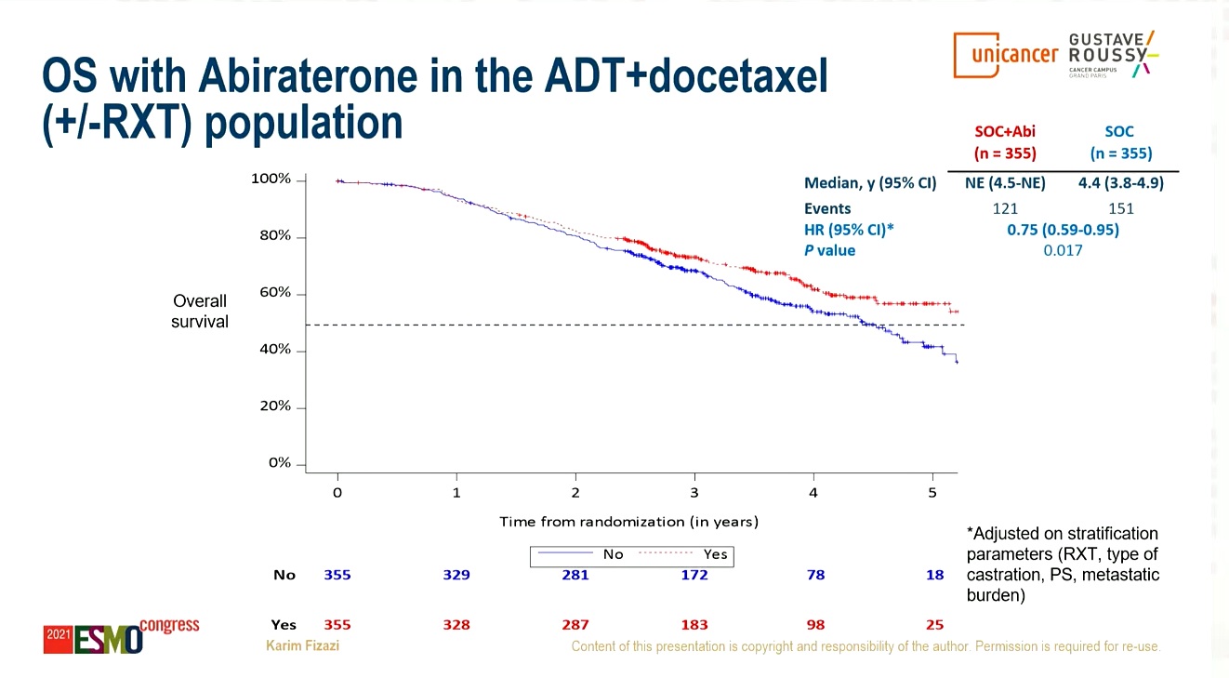
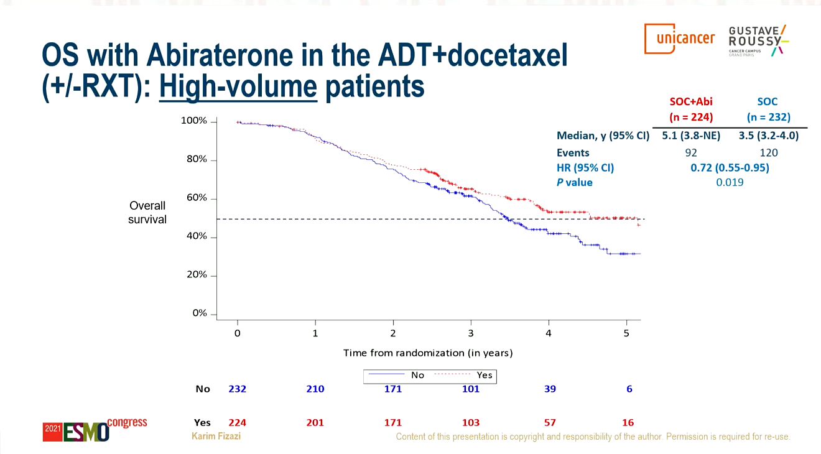
PEACE-1: 2x2 Randomized Trial of ADT+ Docetaxel +/- XRT and +/- Abiraterone
Fizazi K, et al ESMO 2021

Slide 11
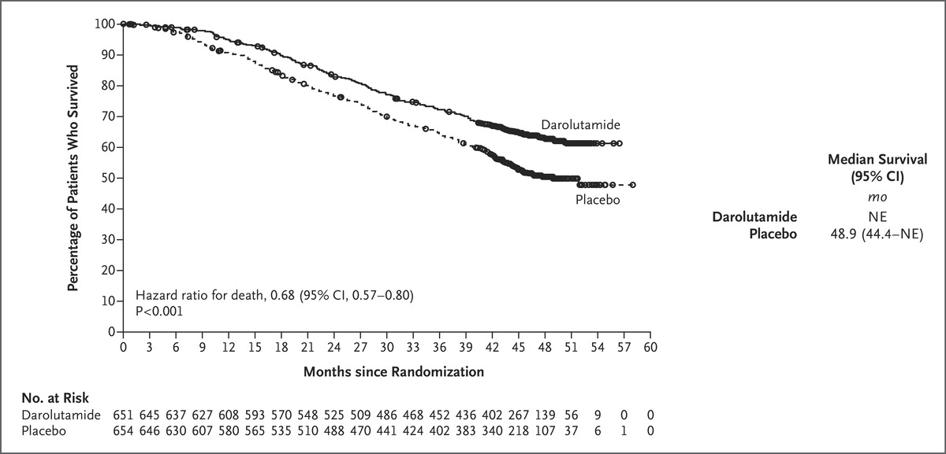
ADT, Docetaxel and Darolutamide Improves OS vs ADT, Docetaxel and Placebo (ARASENS)

Slide 12
Phase 3 Trials of ARPI in nmCRPC Establish MFS as a Primary End Point
 | ARAMIS¹⁻³ |  |  | SPARTAN^{4,5} |  |  | PROSPER^{6,7}
Intervention | Darolutamide vs Placebo |  |  | Apalutamide vs Placebo |  |  | Enzalutamide vs Placebo
Study design | Randomized (2:1); PSADT (≤6 vs >6 mo) and use of osteoclast-targeted therapy |  |  | Randomized (2:1); stratified based on PSADT (≤6 mo vs >6 mo), use of osteoclast-targeted therapy, and presence of locoregional disease |  |  | Randomized (2:1); stratified by PSADT (<6 mo vs ≥6 mo) and use of osteoclast-targeted therapy
Accrual (targeted / actual) | 1500/1508 |  |  | 1200/1207 |  |  | 1560/1401
Dates | Start date | PCD | Final completion | Start date | PCD | Final completion | Start date | PCD | Final completion
 | Sep 2014 | Sep 2018 | Jun 2020 | Oct 2013 | May 2017 | Nov 2021 | Oct 2013 | Jun 2017 | May 2020
Primary end point | MFS, time to metastasis or death
Secondary end points | OS, time to first SSE, time to use of CT, time to pain progression, safety, time to first opiate use |  |  | Time to metastasis, PFS, time to symptomatic progression, OS, time to use of CT, PFS, safety, PK |  |  | Time to PSA progression, time to first use of new antineoplastic therapy, OS, time to first use of CT, HRQoL, time to CT-free disease specific survival, time to CT-free survival, time to pain progression, safety, PSA response rate
Additional end points | PFS, time to first PC-related invasive procedure, initiation of subsequent antineoplastic therapy, PSA progression, PSA response, ECOG status, and HRQoL |  |  | Time to PSA progression, PSA response rate, HRQoL, PFS2 |  |  | NA
AE, adverse event; CT, chemotherapy; ECOG, Eastern Cooperative Oncology Group; HRQoL, health-related quality of life; NA, not available; PC, prostate cancer; PCD, primary completion date; PFS, progression-free survival; PFS2, second-progression-free survival; PK, pharmacokinetics; SSE, symptomatic skeletal event.
1. National Institutes of Health. ClinicalTrials.gov Identifier: NCT02200614. Accessed February 15, 2019. 2. Fizazi K et al. J Clin Oncol. 2015;33(suppl):abstr TPS5080. 3. Fizazi K et al. Expert Rev Anticancer Ther. 2015;15(9):1007-1017. 4. National Institutes of Health. ClinicalTrials.gov Identifier: NCT01946204. Accessed February 15, 2019. 5. Smith MR et al. N Engl J Med. 2018;378(15):1408-1418. 6. National Institutes of Health. ClinicalTrials.gov Identifier: NCT02003924. Accessed February 15, 2019. 7. Hussain M et al. N Engl J Med. 2018;378(26):2465-2474. 8. Bayer [press release]. Whippany, NJ; October 24, 2018. Phase III trial of darolutamide in patients with non-metastatic castration-resistant prostate cancer meets primary endpoint. October 24, 2018. https://www.bayer.us/en/newsroom/press-releases/article/?id=123249. Accessed February 15, 2019.

Slide 13
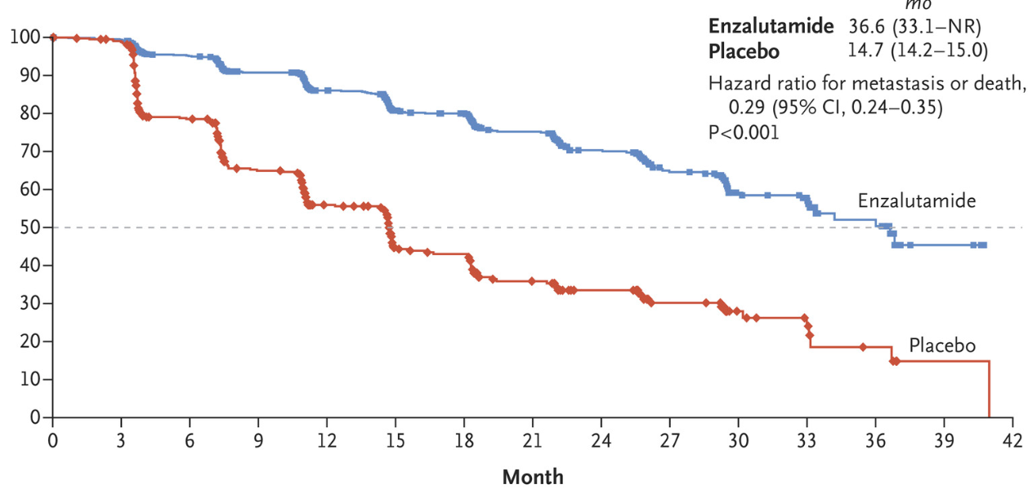
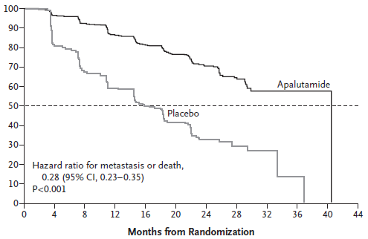
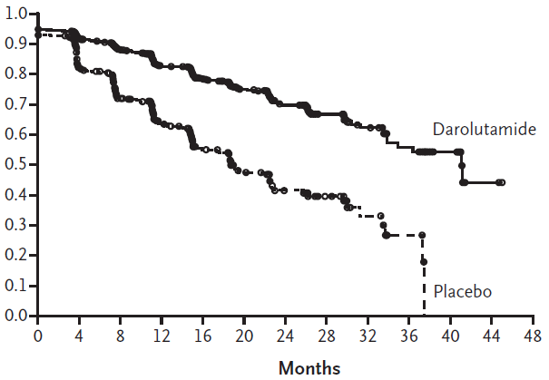
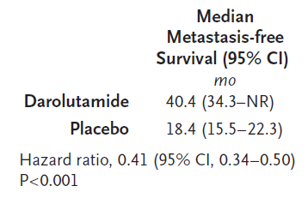
MFS from ARAMIS, SPARTAN and PROSPER Studies
PROSPER
SPARTAN
ARAMIS
Hussain M, et al. N Engl J Med 2018;378:2465–2474
Smith MR, et al. N Engl J Med 2018;378:1408–1418
Fizazi K, et al. N Engl J Med 2019;380:1235–1246

Slide 14
OS from ARAMIS, SPARTAN and PROSPER Studies
PROSPER
SPARTAN
ARAMIS
100
100
90
1.0
80
90
0.9
80
0.8
70
70
Median OS (Mos)
0.7
APA
PBO
60
Median OS
(95% CI), mo
60
73.9
59.9
50
67.0 (64.0-NR)
56.3 (54.4-63.0)
0.6
Patients alive (%)
ENZA
PBO
Patients alive (%)
50
0.5
40
Probability of survival
HR 0.69 (95% CI 0.53–0.88); P=0.003
40
HR 0.78 (95% CI: 0.64–0.96); P=0.016
0.4
30
30
0.3
20
HR 0.73 (95% CI: 0.61–0.89);
P=0.001
20
0.2
DARO
PBO
10
10
0.1
0
0
0.0
0
12
24
36
48
60
72
0
12
24
36
48
60
72
0
4
8
12
16
20
24
28
32
36
40
44
48
52
56
60
Months from randomisation
Months from randomisation
Months
Sternberg CN, et al. N Engl J Med 2020;382:2197–2206
Smith MR, et al. Eur Urol 2021;79(1):150–158
Fizazi K, et al. N Engl J Med 2020;383(11):1040–1049

Slide 15
mCRPC Has a Poor Prognosis^{1,2}
Metastasis
Median OS: 1.8-2.8 years^{1,2}
1st-Line Therapy^{3,4}
2nd-line Therapy⁵⁻⁷
3rd-line Therapy⁸
Median OS
~35 months
Median OS
15-18 months
Median OS
11-14 months
5-year OS is 26%¹
Factors associated with improved prognosis:¹
ECOG PS 0 vs 1
Received 5-12 systemic agents vs <3 systemic agents
Longer PSA-DT
mCRPC median survival is evolving with the approval of new therapies
ECOG PS, Eastern Cooperative Oncology Group Performance Status; mCRPC, metastatic castration resistant prostate cancer; OS, overall survival; PSA-DT, prostate-specific antigen doubling time. 1. Francini E et al. J Clin Oncol. 2019;36(6_suppl):203. 2. George DJ et al. Clin Genitourin Cancer. 2020;S1558-7673(19)30392-1. 3. Ryan CJ et al. Lancet Oncol. 2015;16(2):152-160. 4. Beer TM, et al. N Engl J Med. 2014;371(5):424-433. 5. de Bono JS, et al. Lancet. 2010;376:1147-1154. 6. de Bono JS, et al. N Engl J Med. 2011;364(21):1995-2005. 7. Scher HI, et al. N Engl J Med. 2012;367(13):1187-1197. 8. de Wit R, et al. N Engl J Med. 2019;381(26):2506-2518.

Slide 16
There Are 10 FDA-Approved Treatment Options in mCRPC^{1,2}
2nd-Generation
ARis
Abiraterone
Enzalutamide
Usually administered with continued ADT
May include additional treatments for bone metastases:
Denosumab
Zoledronic acid
Radiation as needed
Cell-Based Immunotherapy
Sipuleucel-T
Immunotherapy
Pembrolizumabª
Alpha Therapy
Radium-223
Radioligand directed Therapy
Lutetium Lu 177 vipivotide tetraxetan
Taxanes
Docetaxel
Cabazitaxel
PARP Inhibitors
Olaparib
Talazoparib
Rucaparib
Niraparib
ADT, androgen deprivation therapy; ARi, androgen receptor inhibitor; FDA, Food and Drug Administration; PARP, poly (ADP-ribose) polymerase.
ªFor treatment of microsatellite instability-high (MSI-H) or mismatch repair deficient (dMMR) CRPC after failure of at least one systemic treatment.
1. NCCN. Prostate Cancer V2.2020. https://www.nccn.org/professionals/physician_gls/pdf/prostate_blocks.pdf. Accessed July 8, 2020. 2. Linder S, et al. Endocr Relat Cancer. 2018;26(1):R31-R52.

Slide 17
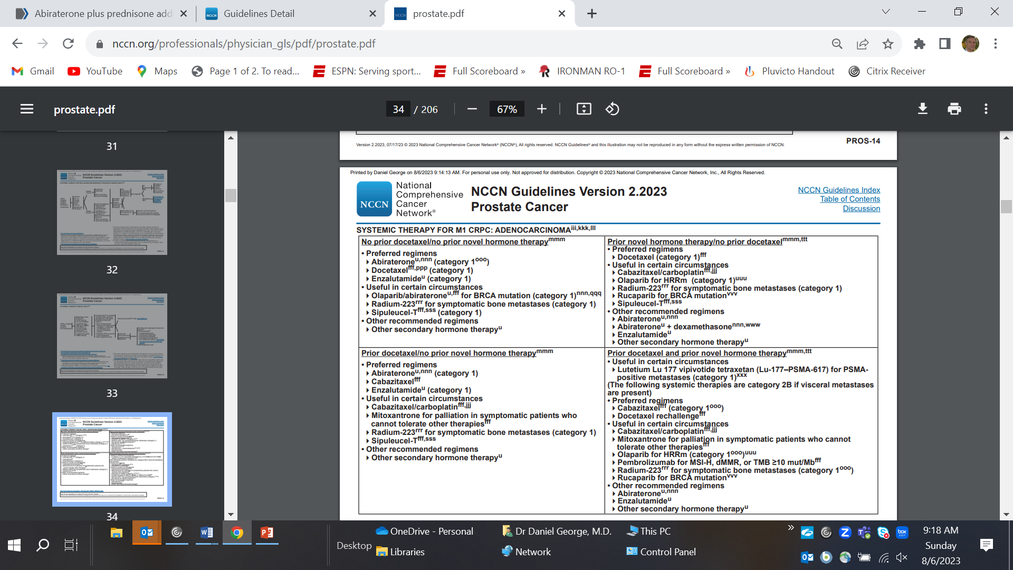

Slide 18
NCCN Version 2.2023 Prostate
Systemic Therapy for M1 CRPC: Adenocarcinoma

Slide 19
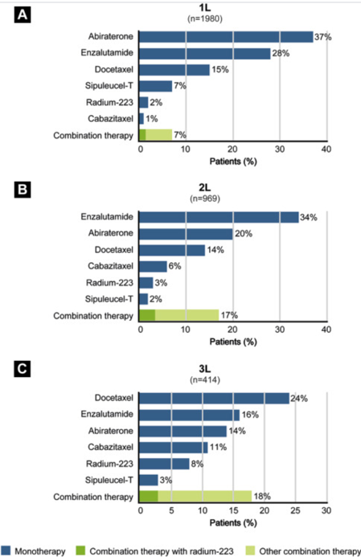
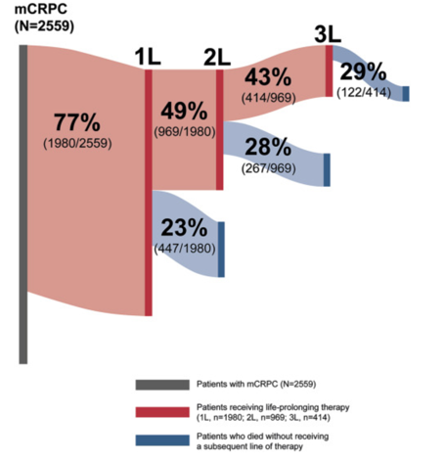
Flatiron Real World Data: Less than 50% of Patients Receive > 2 lines of treatment
George DJ, et al Clin GU Cancers 2020

Slide 20
Charles, 83 yo man diagnosed with PCa in 2002
09/06/2002 Diagnosed with high-risk prostate cancer (clinical T1c, Gleason 8, PSA 59.4); CT and bone scan: no metastases 4/3/2003 Completed 6 months of ADT and definitive radiation therapy to prostate and seminal vesicles (78 Gy,) 8/17/2006 PSA 279 CT: Extensive retroperitoneal and pelvic lymphadenopathy, consistent with metastatic prostate cancer. Indeterminate rib lesion on bone scan 2006-2015 Intermittent ADT 3/2015 PSA 65 5/27/15 Completed radiation treatment to the para-aortic nodes (50.4Gy) restarted in ADT continuously 5/23/16 PSA 7.77 bone scan negative; CT with iliac bone met and retroperitoneal nodes 11/15/16 PSA 11.17 T < 10 consistent with mCRPC 01/13/17 - 2/10/17: Provenge X 3 followed by RPLND 10/2/17 PSA 43.99 11/6/17 Invitae no inherited genetic alterations 12/6/17 PSA 72.97 BS NED started enzalutamide 2/28/18 PSA 0.57 CT/BS NED 12/2/19 PSA 0.03 CT/BS NED 12/2/20 PSA 0.06 CT/BS NED 7/26/21 PSA 0.45 CT/BS NED 9/21/21 PSA 0.33 PSMA PET/CT - 7 mm para-aortic nodes, 2 small indetermiate bone lesions. 3/28/22 PSA 4.10 CT/BS - 0.8 cm peri-aortic node slightly enlarged. 6/30/22 PSA 14.24 Bone scan – no activity; CT – 1.1 cm PA node, persistent sclerotic/lytic changes in L iliac crest 7/6/22 enrolled onto the PSMAfore study

Slide 21
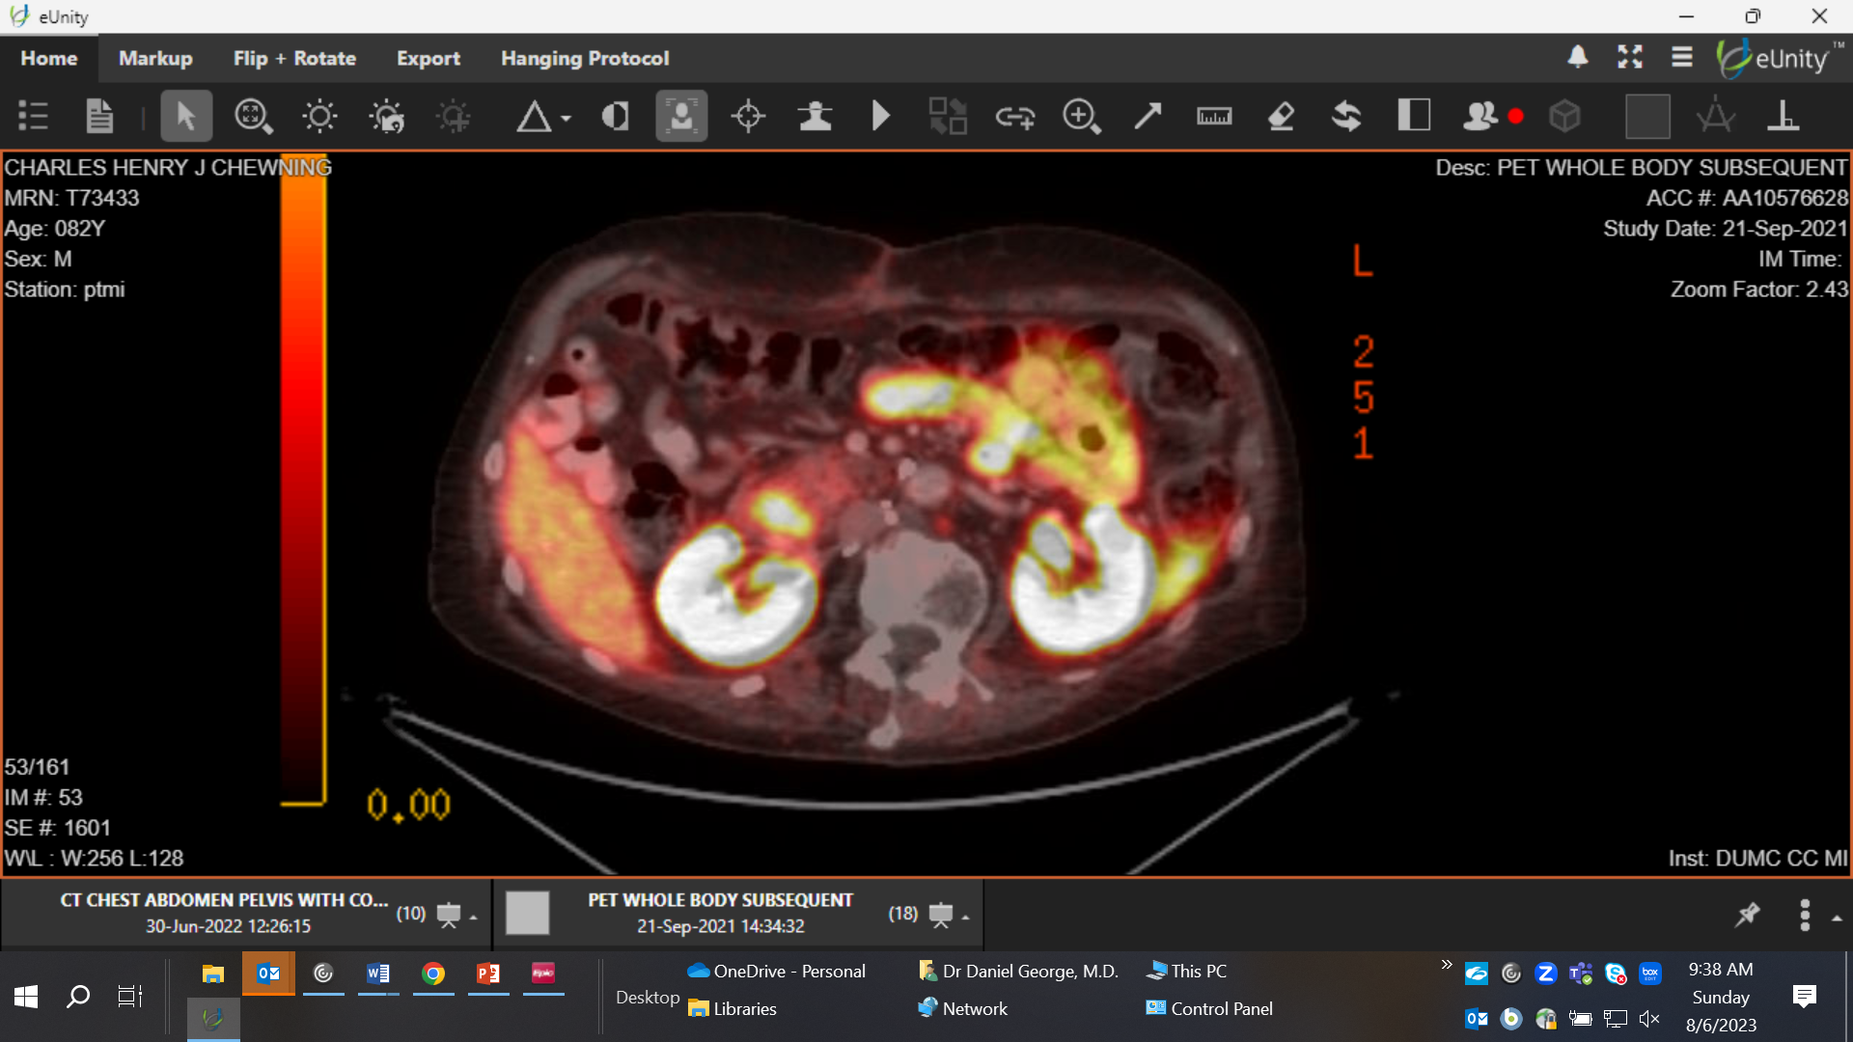
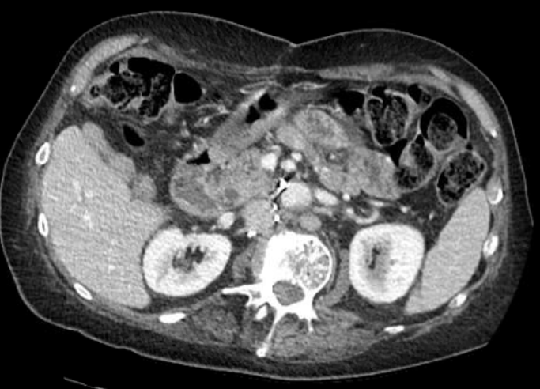
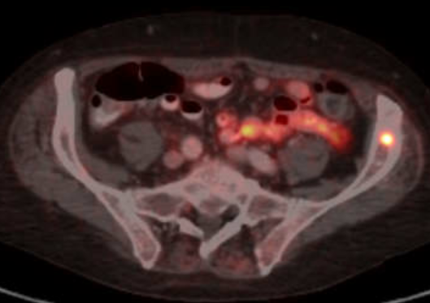
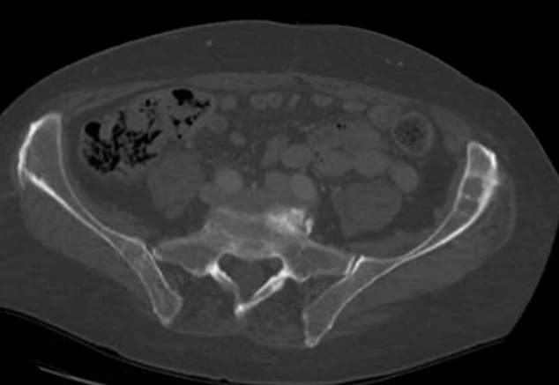
Pre-treatment Scans
9-21-21
6-30-22

Slide 22
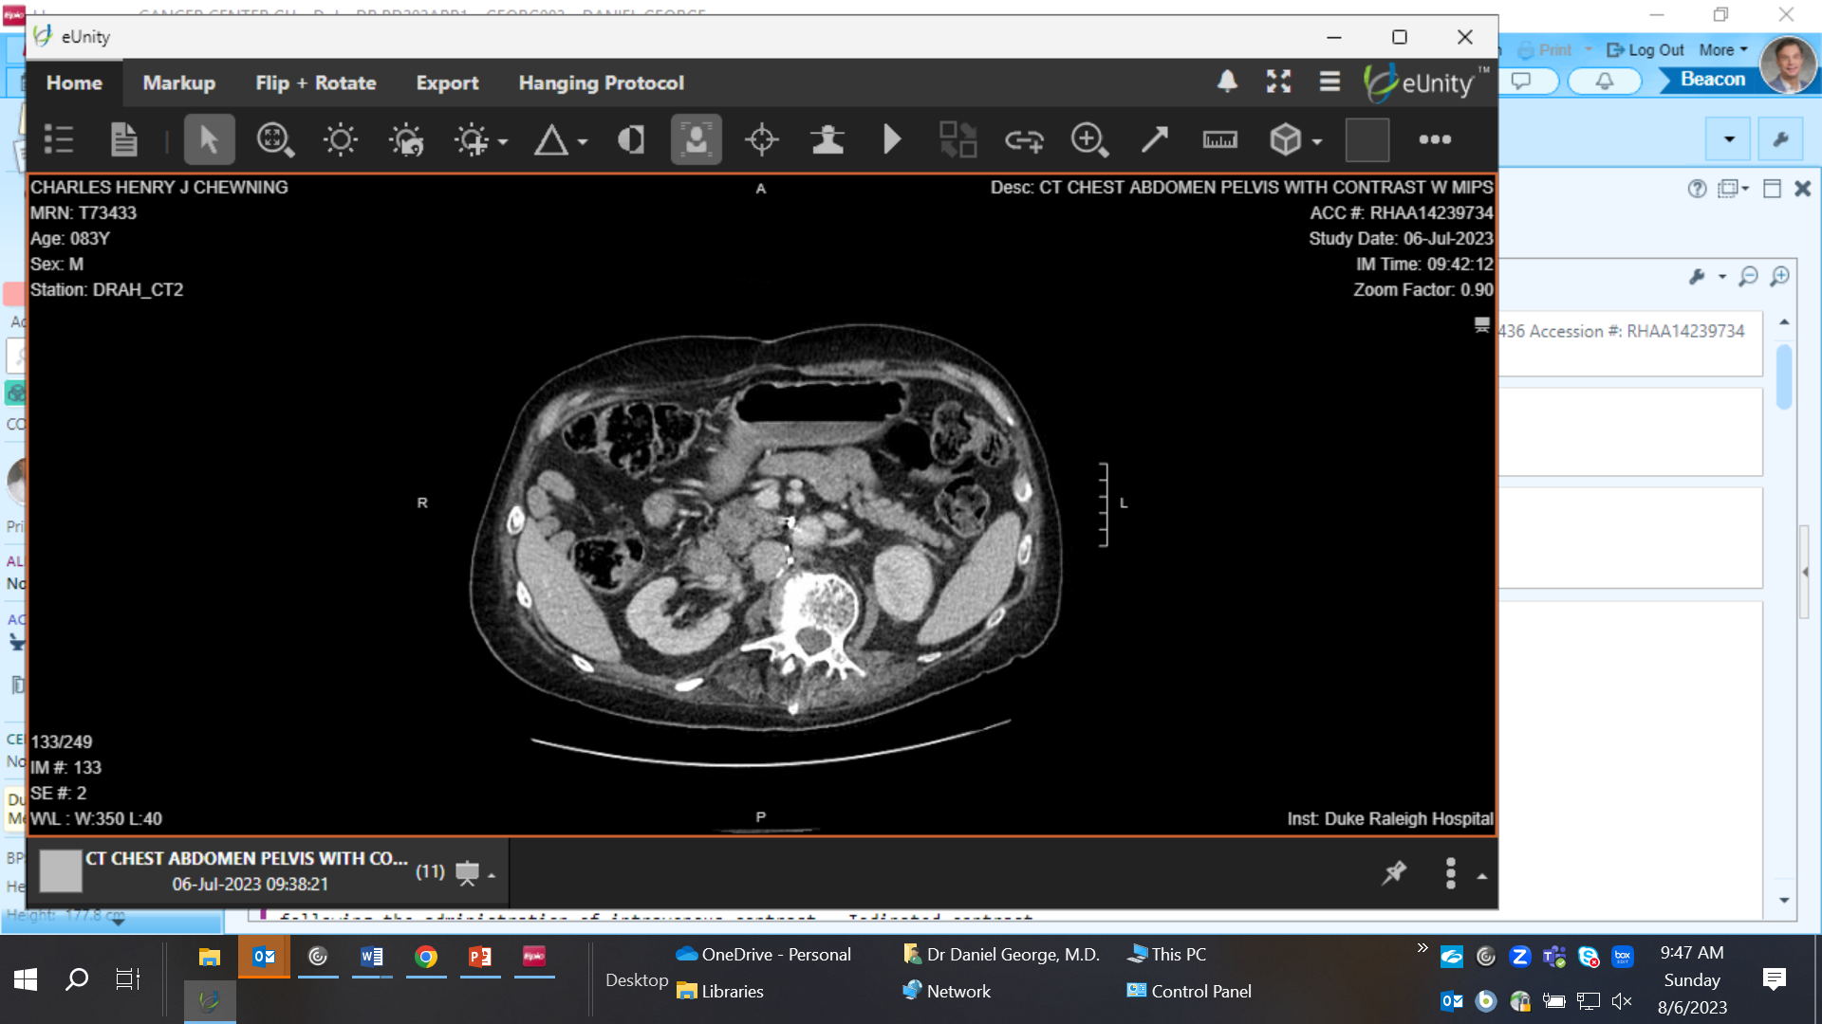

Charles, 1 year on PSMAfore
6-30-22
8/10/22 PSA 19.15; C1 177Lu-PSMA-617 on PSMAfore study 9/21/22 PSA 3.05; C2 177Lu-PSMA-617 12/14/22 PSA 0.56 BS/CT - stable no new mets; C4 177Lu-PSMA-617 4/20/23 PSA C6 177Lu-PSMA-617 7/7/23 PSA 0.03
6-30-22
7-6-23
7-6-23

Slide 23
Malcolm, a 75 yo man diagnosed in 2008
Postate Cancer 2008 Diagnosed with PSA of 3.0; cT2a. TRUS/bx: Gleason 3+3 adenocarcinoma involving multiple cores on the right and 3+4 adenocarcinoma involving multiple cores on the left side 2008 RRP: pT2cN0Mx Gleason 3+4 prostate adenocarcinoma involving 5% of the gland. No ECE or SVI. Margins negative. 3/2009 PSA <0.1 6/2010 PSA 0.2 2/2011 PSA 0.3 Bone scan negative. Treated with salvage RT 10/7/2011 PSA < 0.1 11/2014 PSA 0.1 7/31/2015 PSA 0.4 11/13/2015 PSA 0.8 6/15/16 PSA 1.22 T 469 bone scan and CT NED 4/23/18 PSA 5.57 BS negative, CT punctate sclerotic lesions in spine, ribs, pelvis 9/20/18 PSA 12.6 enrolls onto the HERO study, randomized to the relugolix arm. 8/26/19 PSA 0.12 T 11 9/25/19 PSA 0.66 T 471 11/18/19: PSA 2.97 T 376 1/27/20: PSA 9.66. PET Innumerable sclerotic lesions throughout the axial skeleton, consistent with osseous metastatic disease. Start lupron + enzalutamide

Slide 24
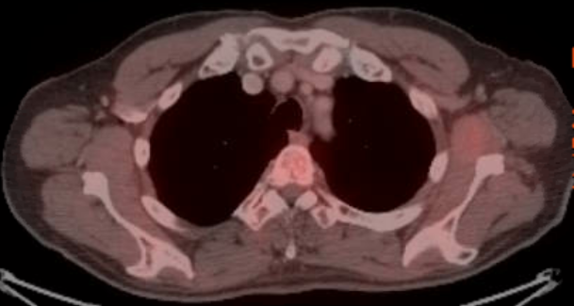
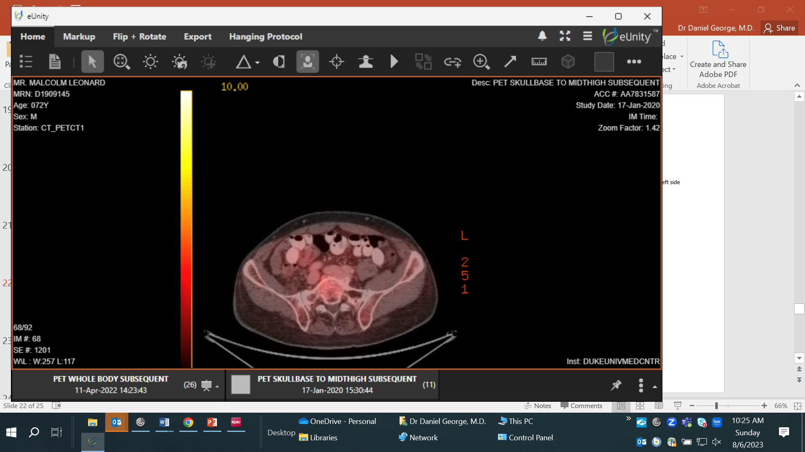
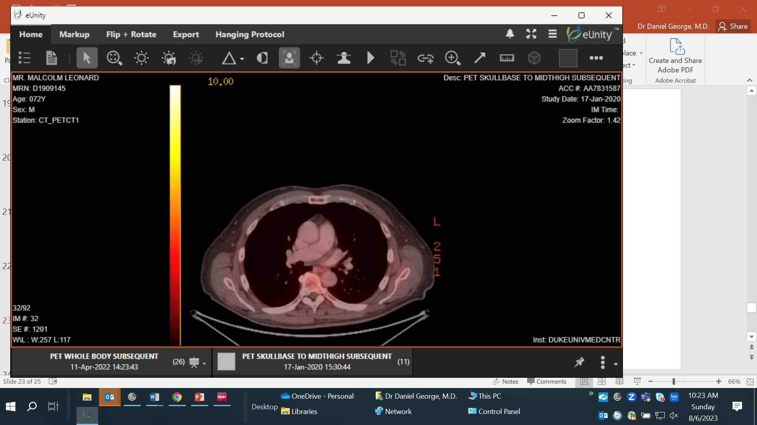
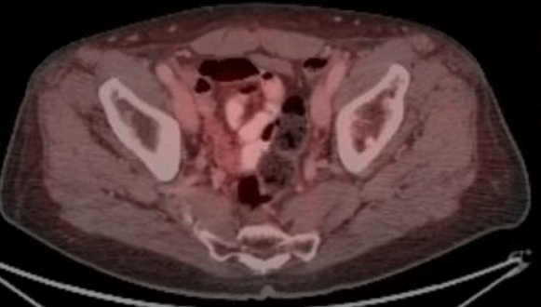
1-17-2020 F¹⁸ Fluciclovine PET CT
Impression:
1. No abnormal 18F-Fluciclovine uptake.
2. Innumerable sclerotic lesions throughout the axial skeleton, consistent with osseous metastatic disease.

Slide 25
Malcolm, continued…
2/2/20 Started on Lupron and enzalutamide
3/2/20 PSA 0.22 CPET VO2 peak 24.7 (95% predicted) 4/15/20 PSA<.01 Test 24 7/27/20 PSA 0.03 CT/BS stable 10/27/20 PSA 0.02 CPET VO2 peak 20.9% (80% predicted) 10/7/21 PSA 0.03 enzalutamide lowered to 120 mg daily (fatigue) 1/31/21 PSA 0.45 Increased enzalutamide to 160 mg 3/14/22 PSA 0.80 enzalutamide stopped 4/18/22 PSA 1.35 PSMA PET CT with oligometastatic disease (C5 facet, mid T 12 and right iliac bone).

Slide 26
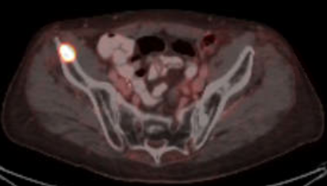
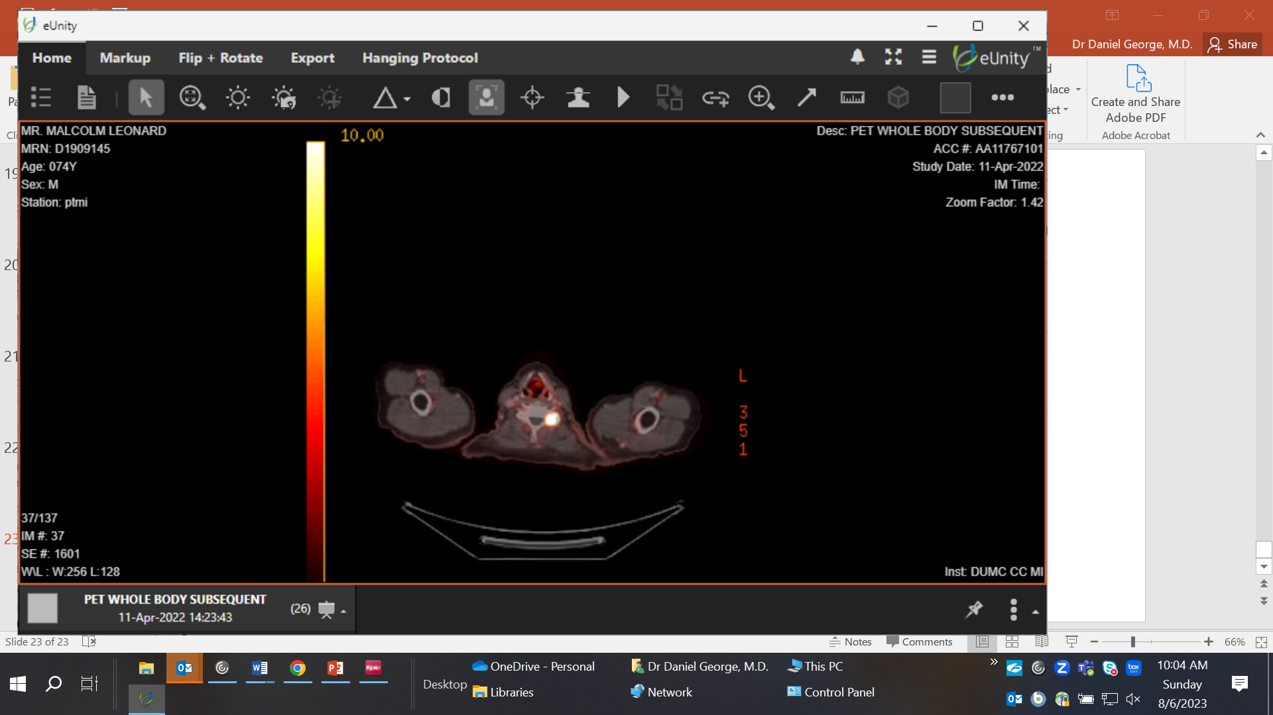

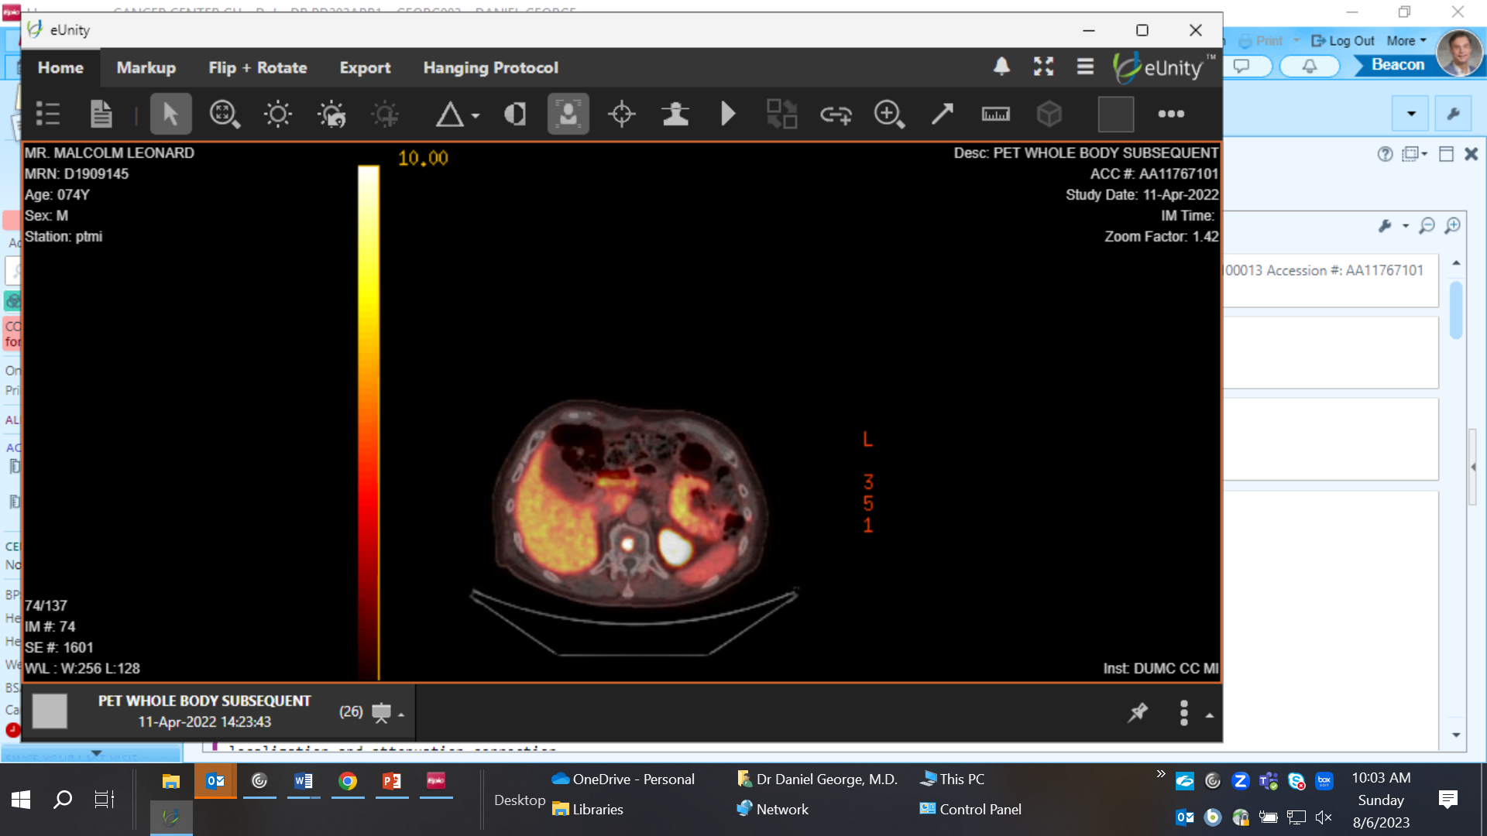
4-11-22 Baseline Scans

Slide 27
Malcolm enrolls onto PSMAfore study
6/7/22 PSA 2.80 Screening for PSMA FORE randomized to the control arm 6/16/22 PSA 3.04; C1D1 PSMA FORE, starting abi/pred 12/1/22: PSA 6.7, CT C/A/P and bone scan stable 2/17/23 PSA 16.77; CT CAP/BS evidence of progressive disease in bone of existing and new lesions 4/5/23 PSA 32.17 CT/BS confirmed progressive disease in bone

Slide 28
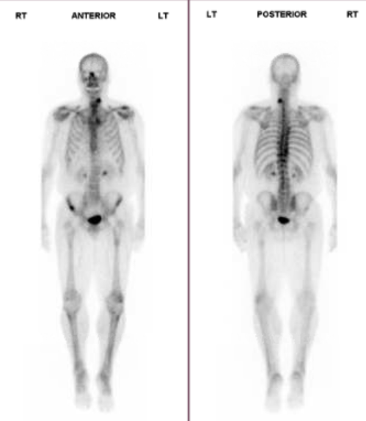
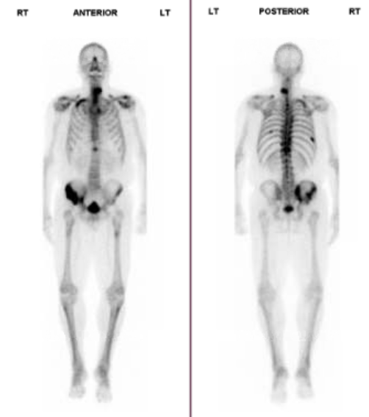
Bone scan progression on PSMAfore
6-7-22
PSA 2.84
4-5-23
PSA 32.17

Slide 29
PSA response on Pluvicto
5/1/23 PSA 54.66 Pluvicto # 1
6/15/23 PSA 35.66 Pluvicto # 2
8/3/23 PSA 42.78 Pluvicto # 3

Slide 30
Optimal Use Cases
Sipuleucel-T: low volume mCRPC, responding well to first line NHA or slow progressors
Abiraterone or enzalutamide: low volume mCRPC (no loss of PTEN/p53/Rb)
Pembrolizumab: MSI-H (MSH2/6 mutations) in early mCRPC
Radium-223: symptomatic mCRPC, bone only with oligo but large osseous mets, high blastic uptake
Lu¹⁷⁷ PSMA (vipivotide tetraxetan): mCRPC anytime after first line NHA
Docetaxel, Cabazitaxel: NHA-treated mCRPC (alternative to Lu¹⁷⁷ PSMA 617 and Radium-223)
Olaparib – early mCRPC in BRCAm with abiraterone
Talazoparib – early mCRPC in HRRm with enzalutamide
Rucaparib – later in mCRPC after NHA, docetaxel in BRCAm

Slide 31
Conclusions
Landscape is changing – but many patients will still have slowly progressive disease on ADT and novel hormonal therapy.
Very exciting opportunity to use Pluvicto in a much more effective disease state.
Early is key - no too small a burden of disease to consider
Education around not switching novel hormonal therapies is critical
Still learning about PET scan interpretation
Responses to Pluvicto should be more robust, durable in earlier disease settings – will need to re-educate from prior experiences.

